Slide 1
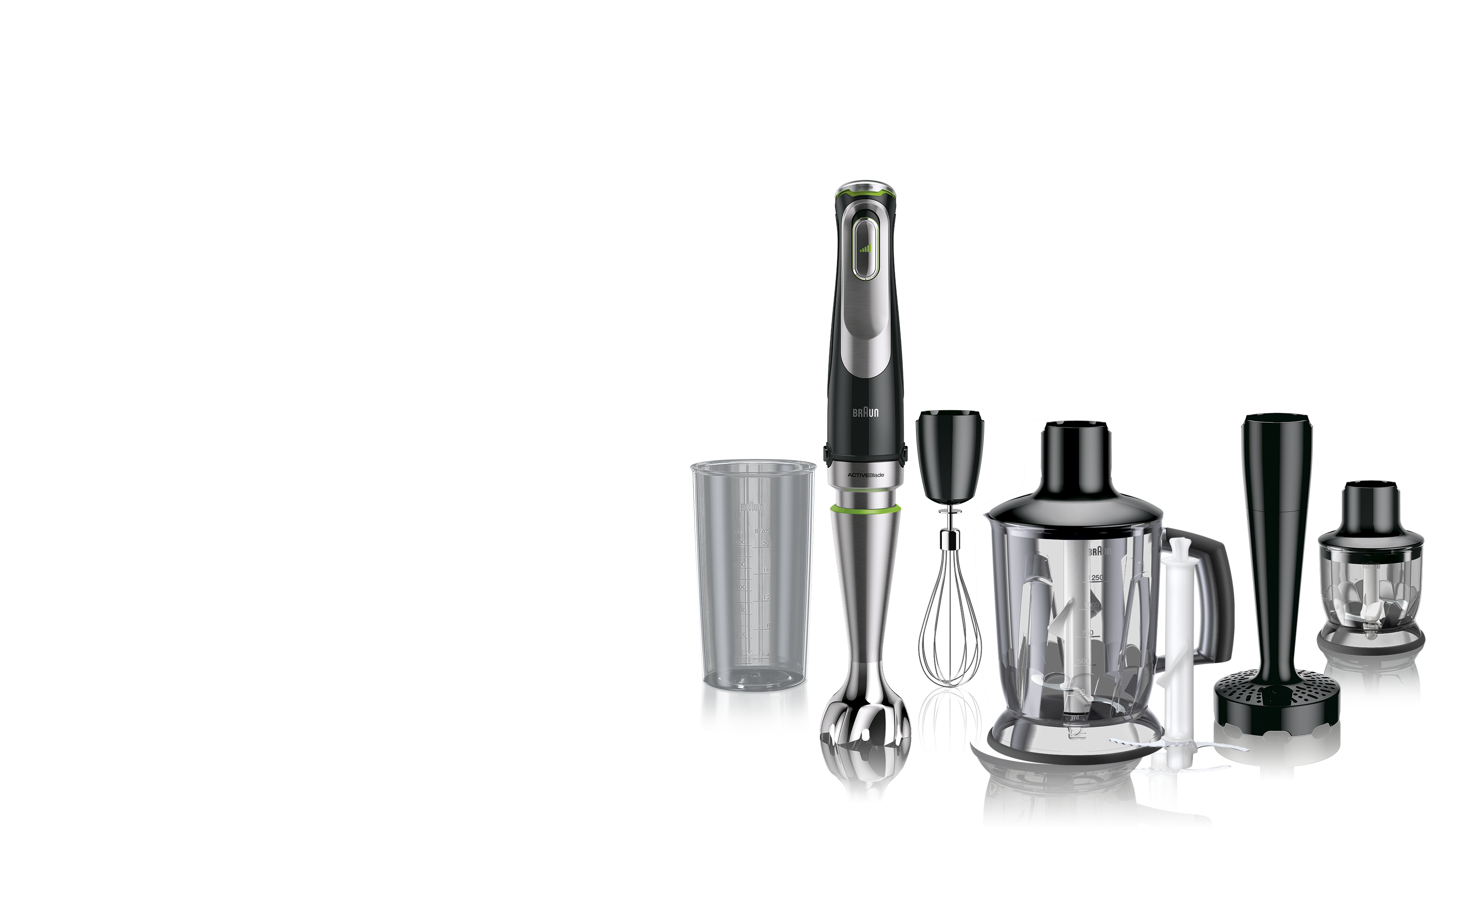
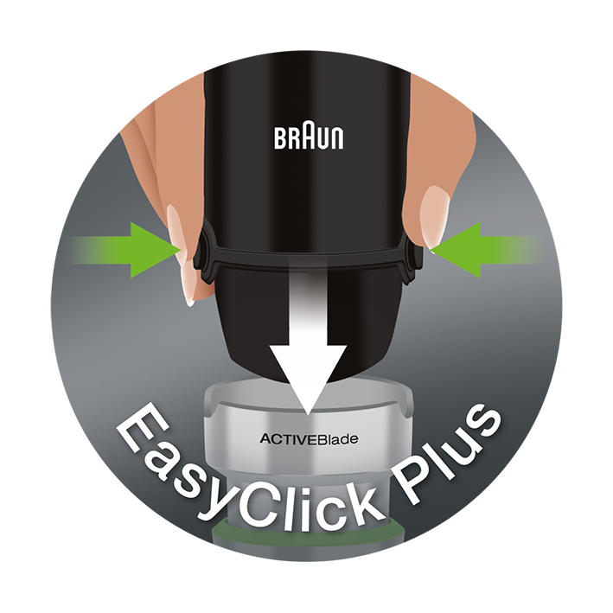
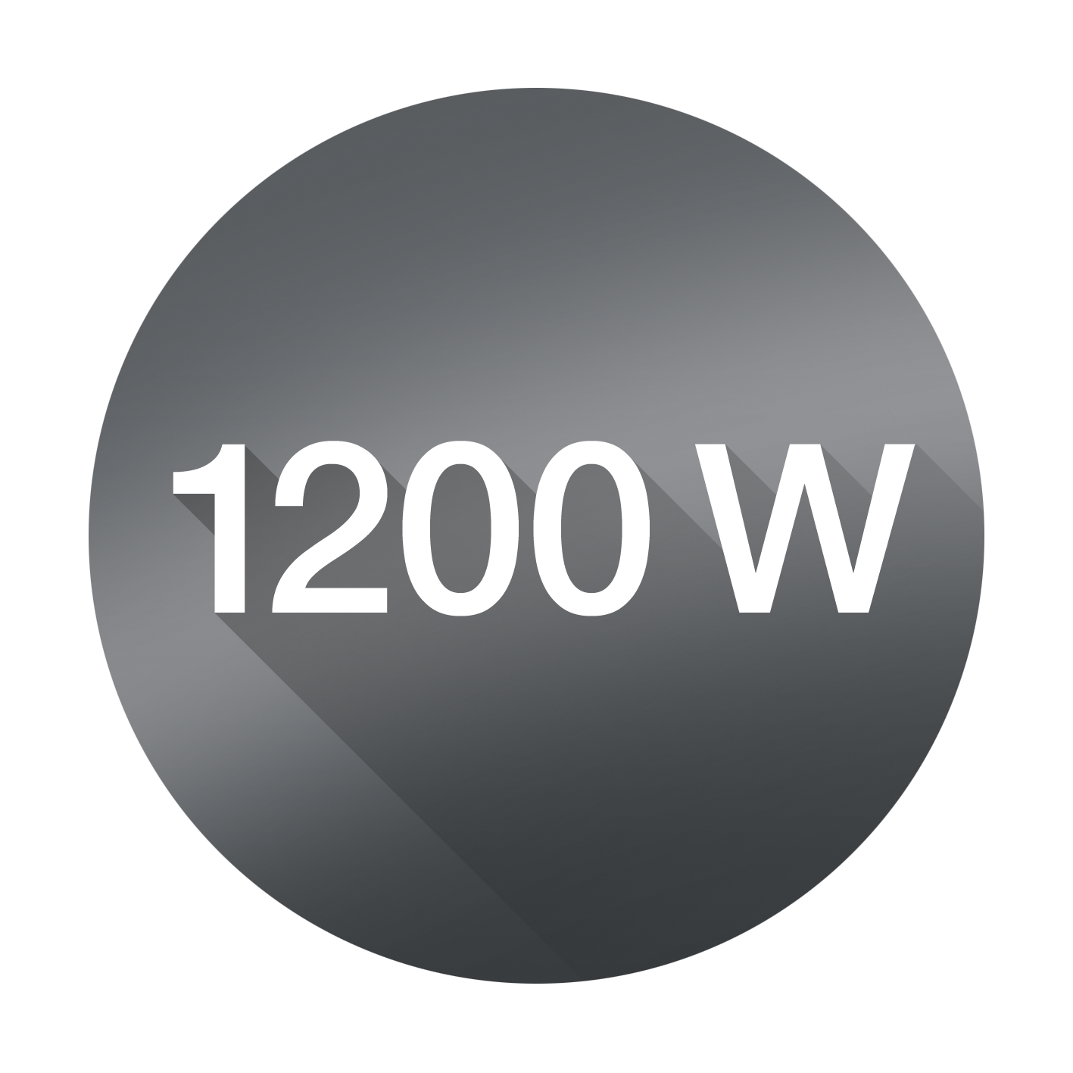
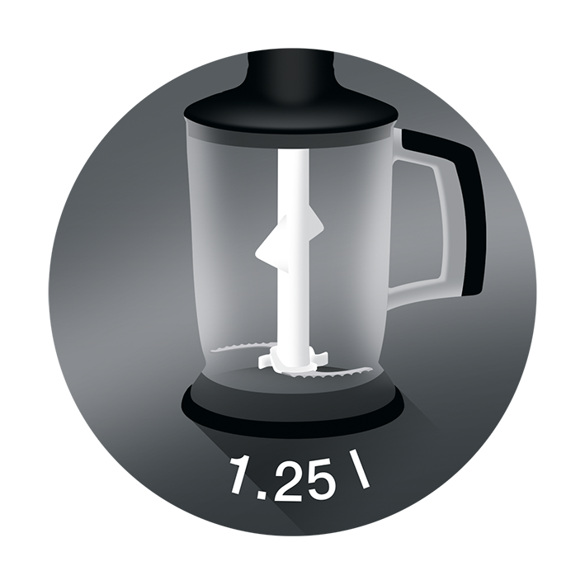
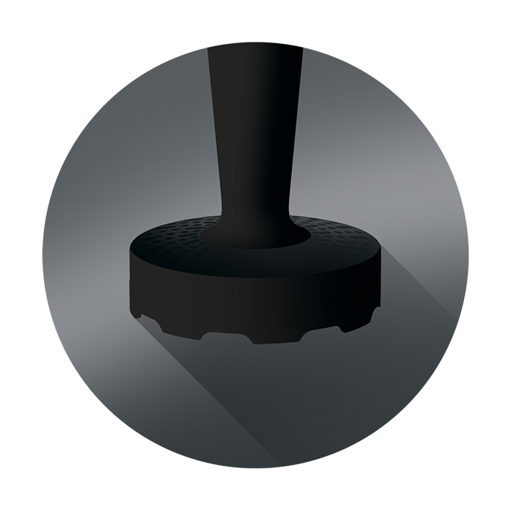
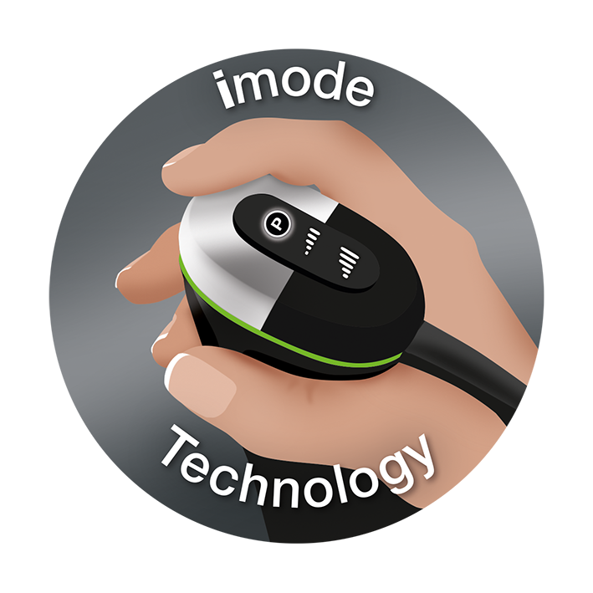
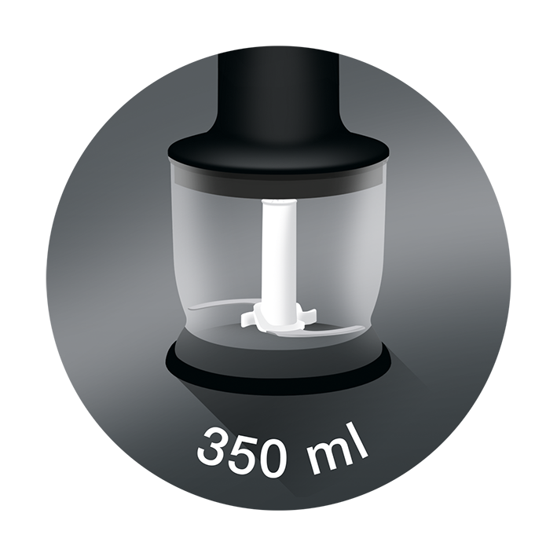
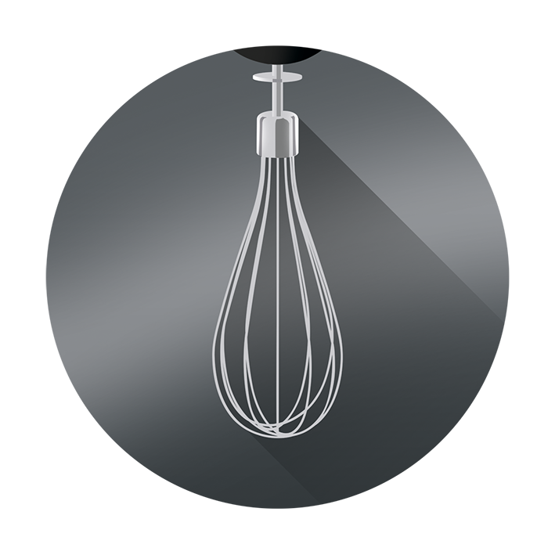
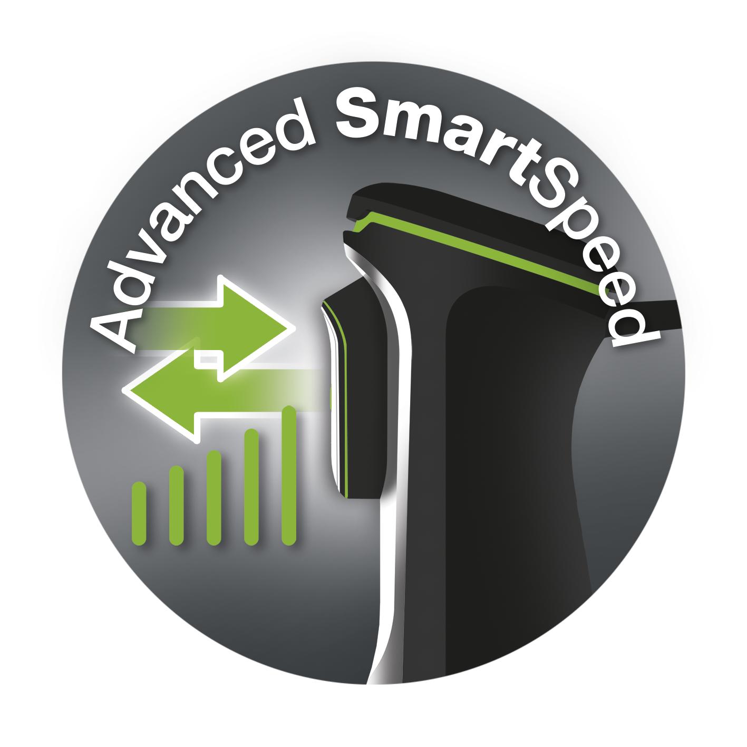
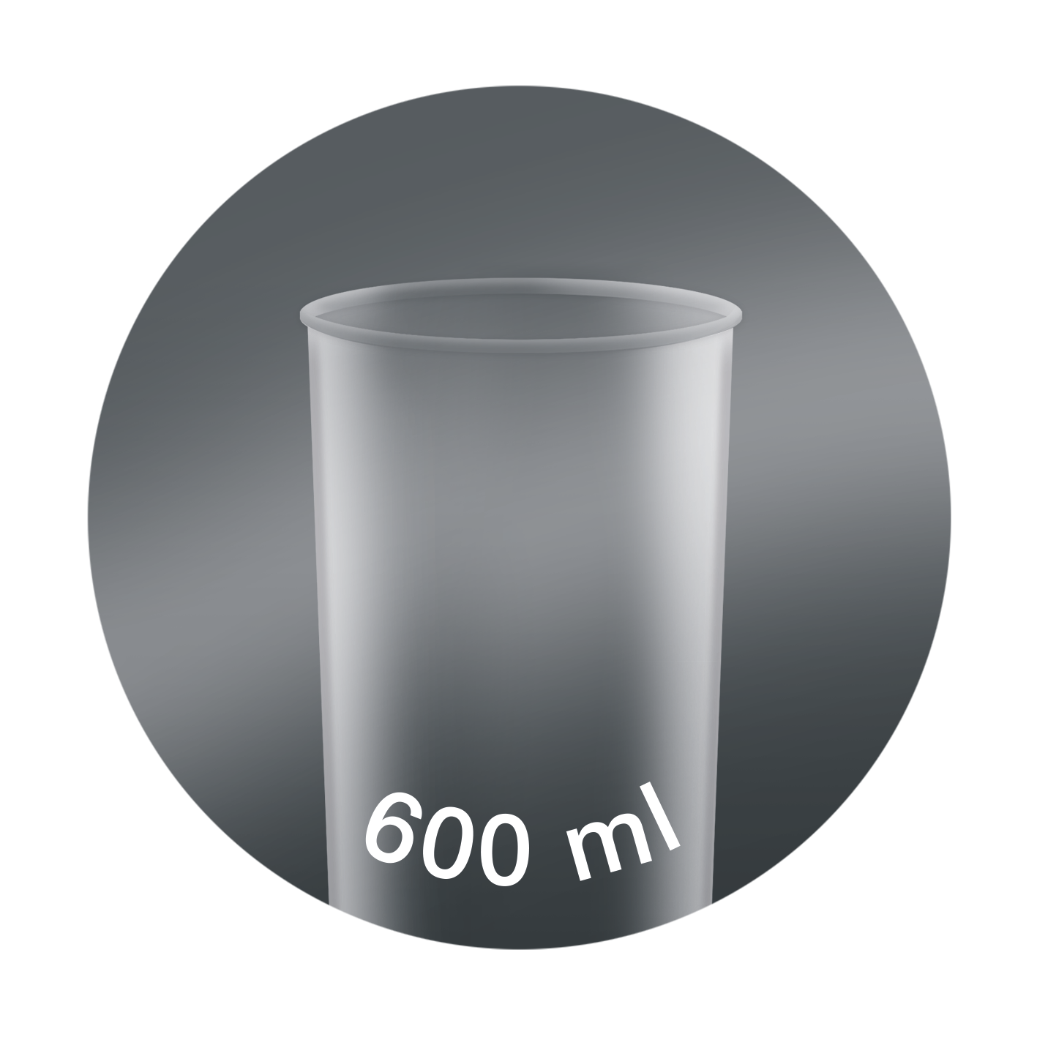
MQ9147X
Product highlights
Technical data
Active PowerDrive technology Braun’s most powerful 1200W highly efficient motor. Up to 6 times finer blending result¹ and 60% faster performance² for tastier, smoother results with no unwanted pieces.
ACTIVEBlade technology World’s first. Blade moves up and down blend even the hardest foods. 2.5 times more active cutting zone³. Up to 40% less effort needed⁴.
imode technology Delivers precise results and ease of use on variety of tasks. Select your speed settings from pulse, low speed, high speed to create your ideal recipe with a touch of a button.
Advanced SmartSpeed The more you squeeze the more power you get. Featuring an extra-large control button for better handling and comfort.
SPLASHControl technology Improved anti-splash for cleaner kitchens.³
EasyClick system Plus Improved connection to exchange accessories faster and easier. Accessories included:
Jug blender / Chopper Blends soups, drinks, dips. Or use as chopper for larger quantities. Includes ice crushing knife and chopping knife.
Purée / masher accessory Effortlessly purée and mash cooked vegetables to a silky smooth result.
Chopper Chops hard cheese, nuts, herbs and carrots in seconds.
Whisk Whips, beats and stirs easily eggs, cream, fluffy dessert from low to high speed.
Beaker 600 ml plastic beaker, BPA free⁵, with ml and fl oz measurements.
Model | MQ 9147X
Type | HB901AI
Colour | premium black/ stainless steel
SKU (INT) | 0X22111377
EAN (INT) | 8021098775153
Power | 1200 W motor
Shaft material | Stainless steel
Dishwasher safe (excluding motor unit and gears) | ●
Soft grip | ●
EasyClick+ connection | ●
Speeds | Advanced SmartSpeed
Product dimensions (motor + shaft) | ca. 410 (H) x 68 Ø mm
Product weight (motor + shaft) | ca. 999g
Giftbox dimensions (L x W x H) | ca. 18,1 x 28,8 x 50,9 cm
Giftbox weight (incl. product) | ca. 2,99 kg
Master carton dimensions (L x W x H) | ca 58,6x 37,2 x 52,7 cm
Master carton weight | ca. 12,79 kg
Accessories include:
Beaker | 600 ml
Whisk | Stainless steel
Chopper | 350ml
Purée accessory | ●
Jug blender / chopper | 1250 ml
Chopping knife | ●
Ice crushing knife | ●
¹ vs. MQ100 on raw vegetable soup ² vs. MQ100 on carrot juice ³ vs. MQ700 ⁴ vs. MQ700 on raw potato
⁵ BPA-free for all parts intended to be in contact with food. Based on third-party testing.
Date of issue: 8-Jul-20 © 2017 De'Longhi Braun Household GmbH

