Slide 1
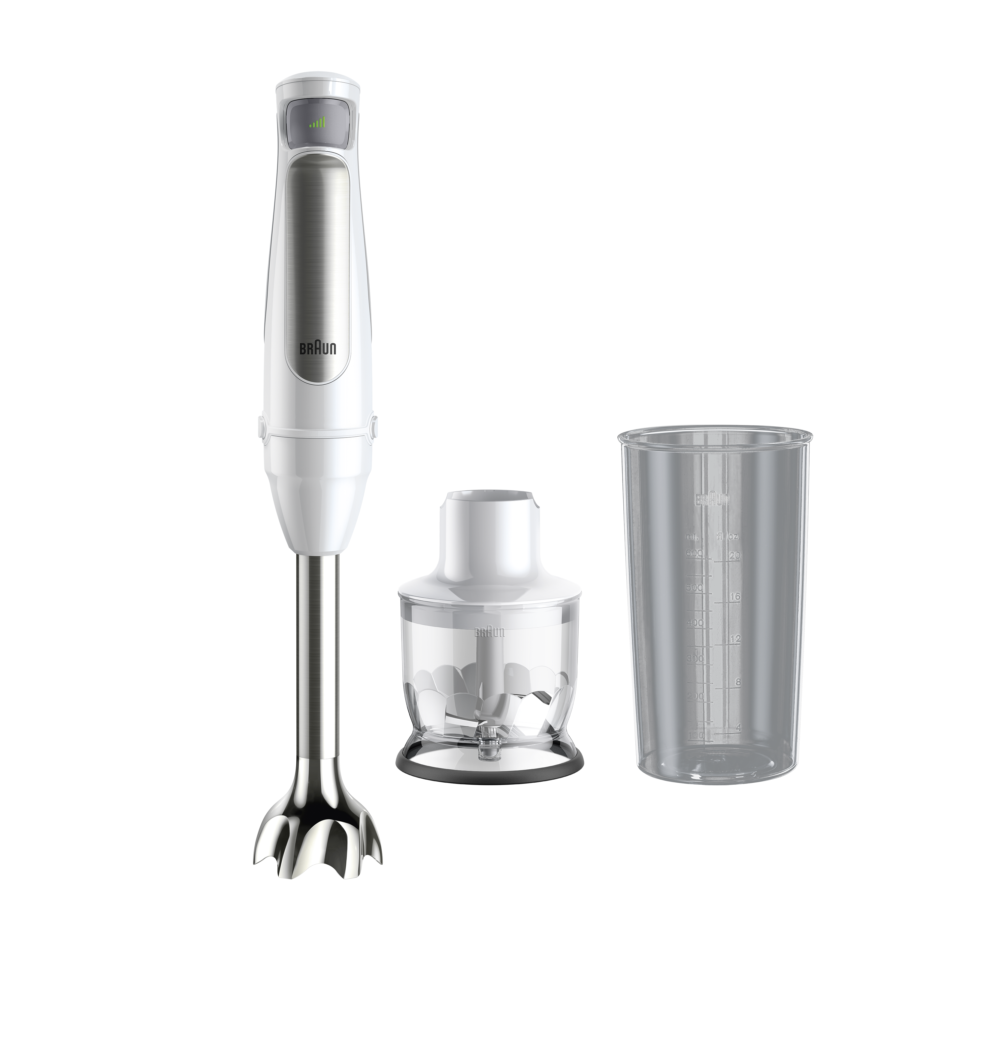
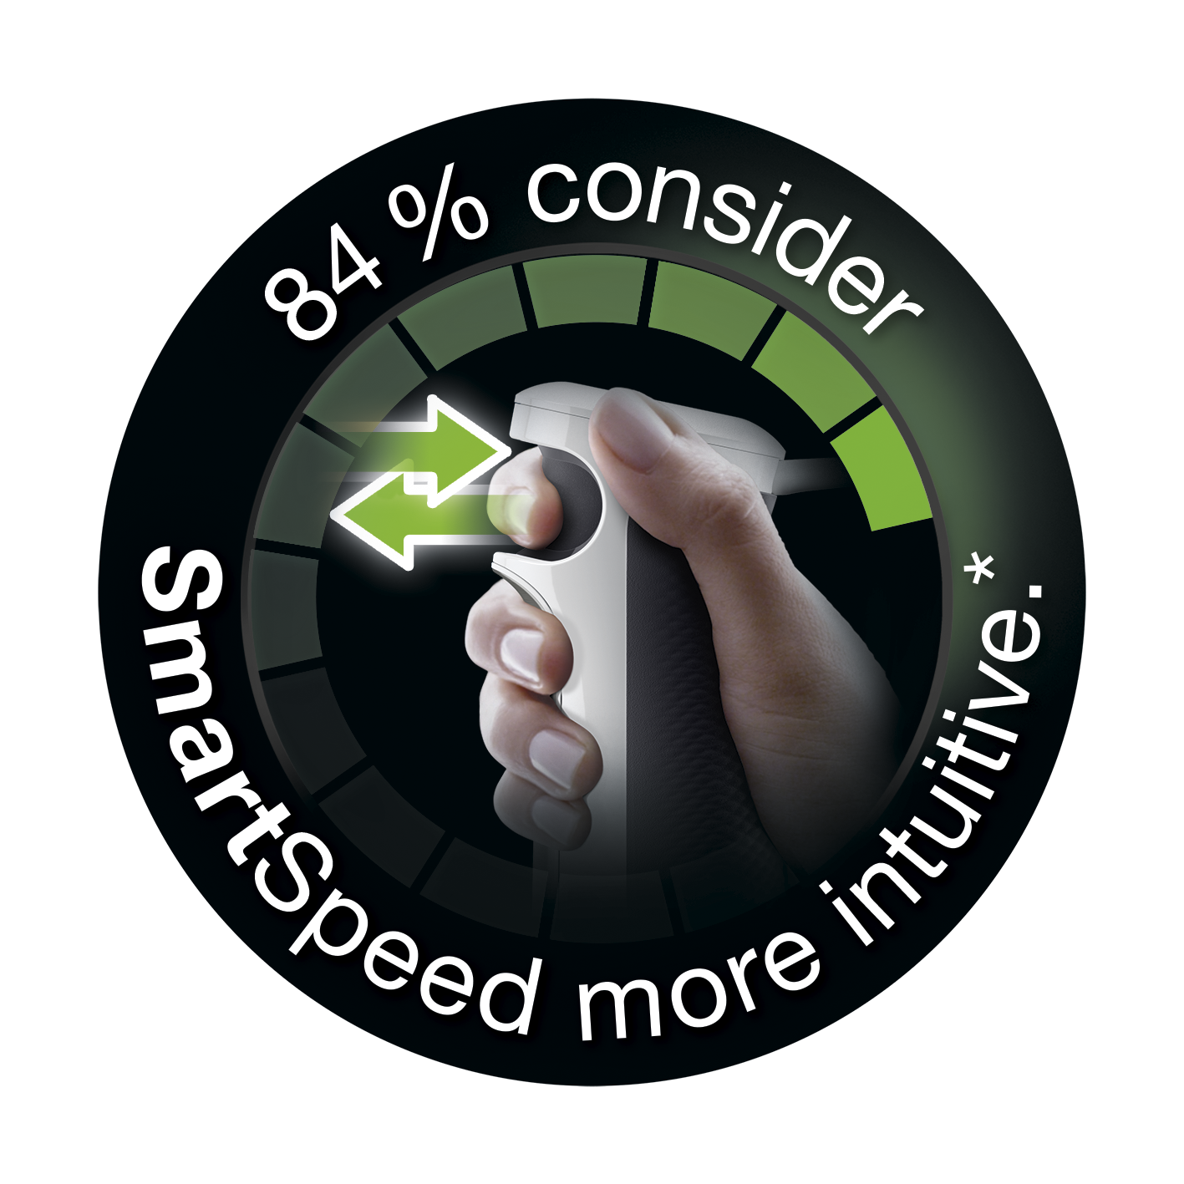
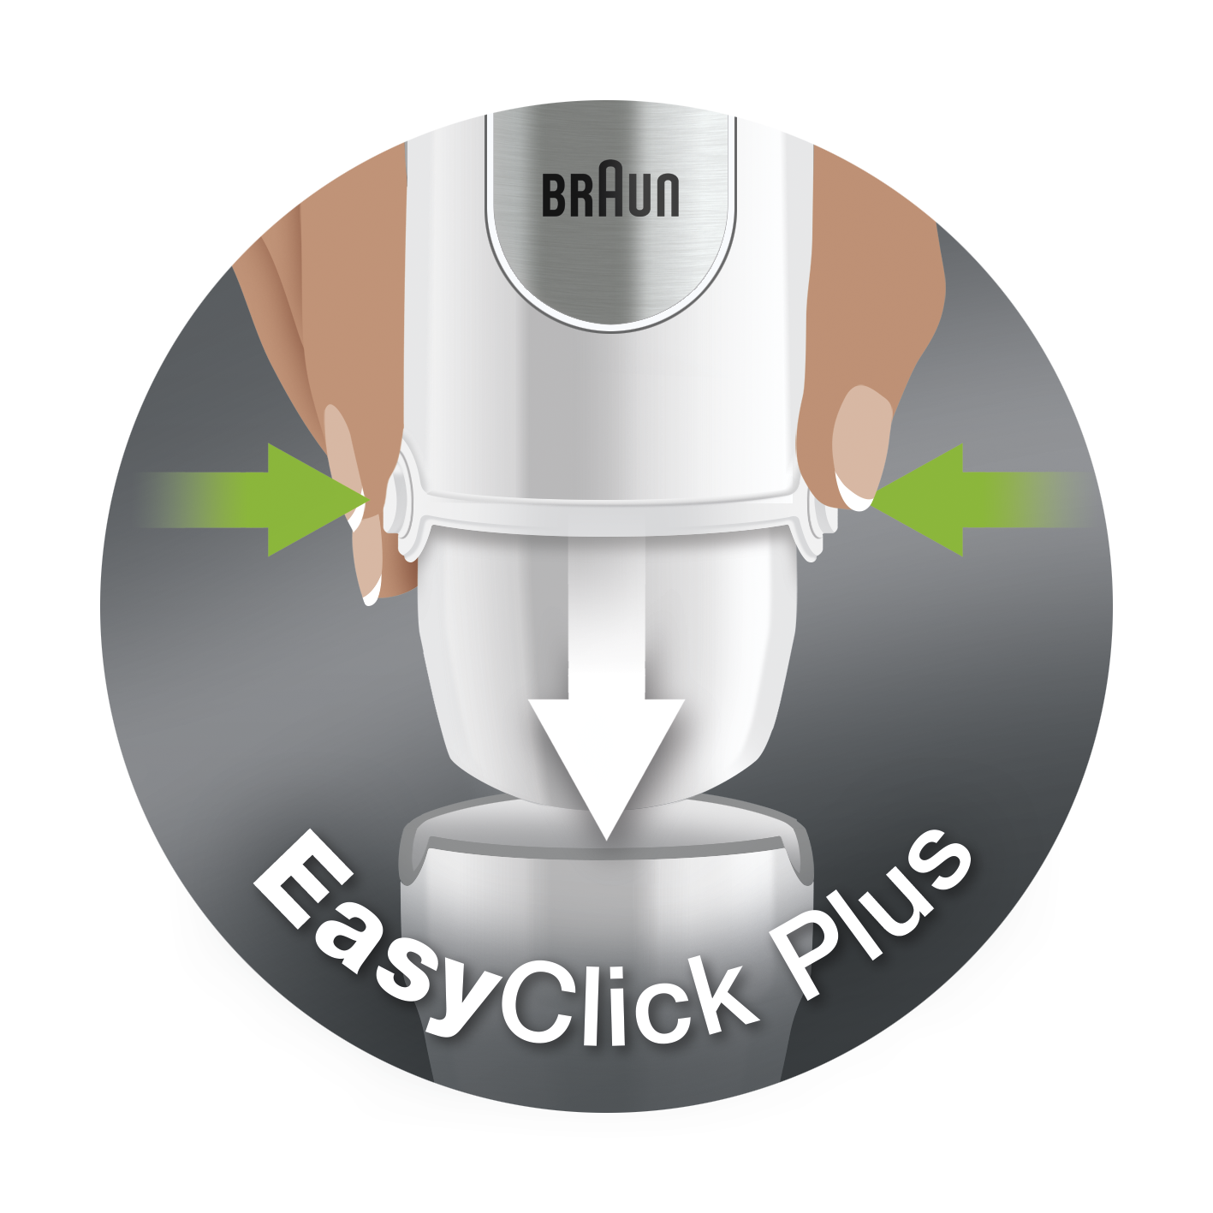
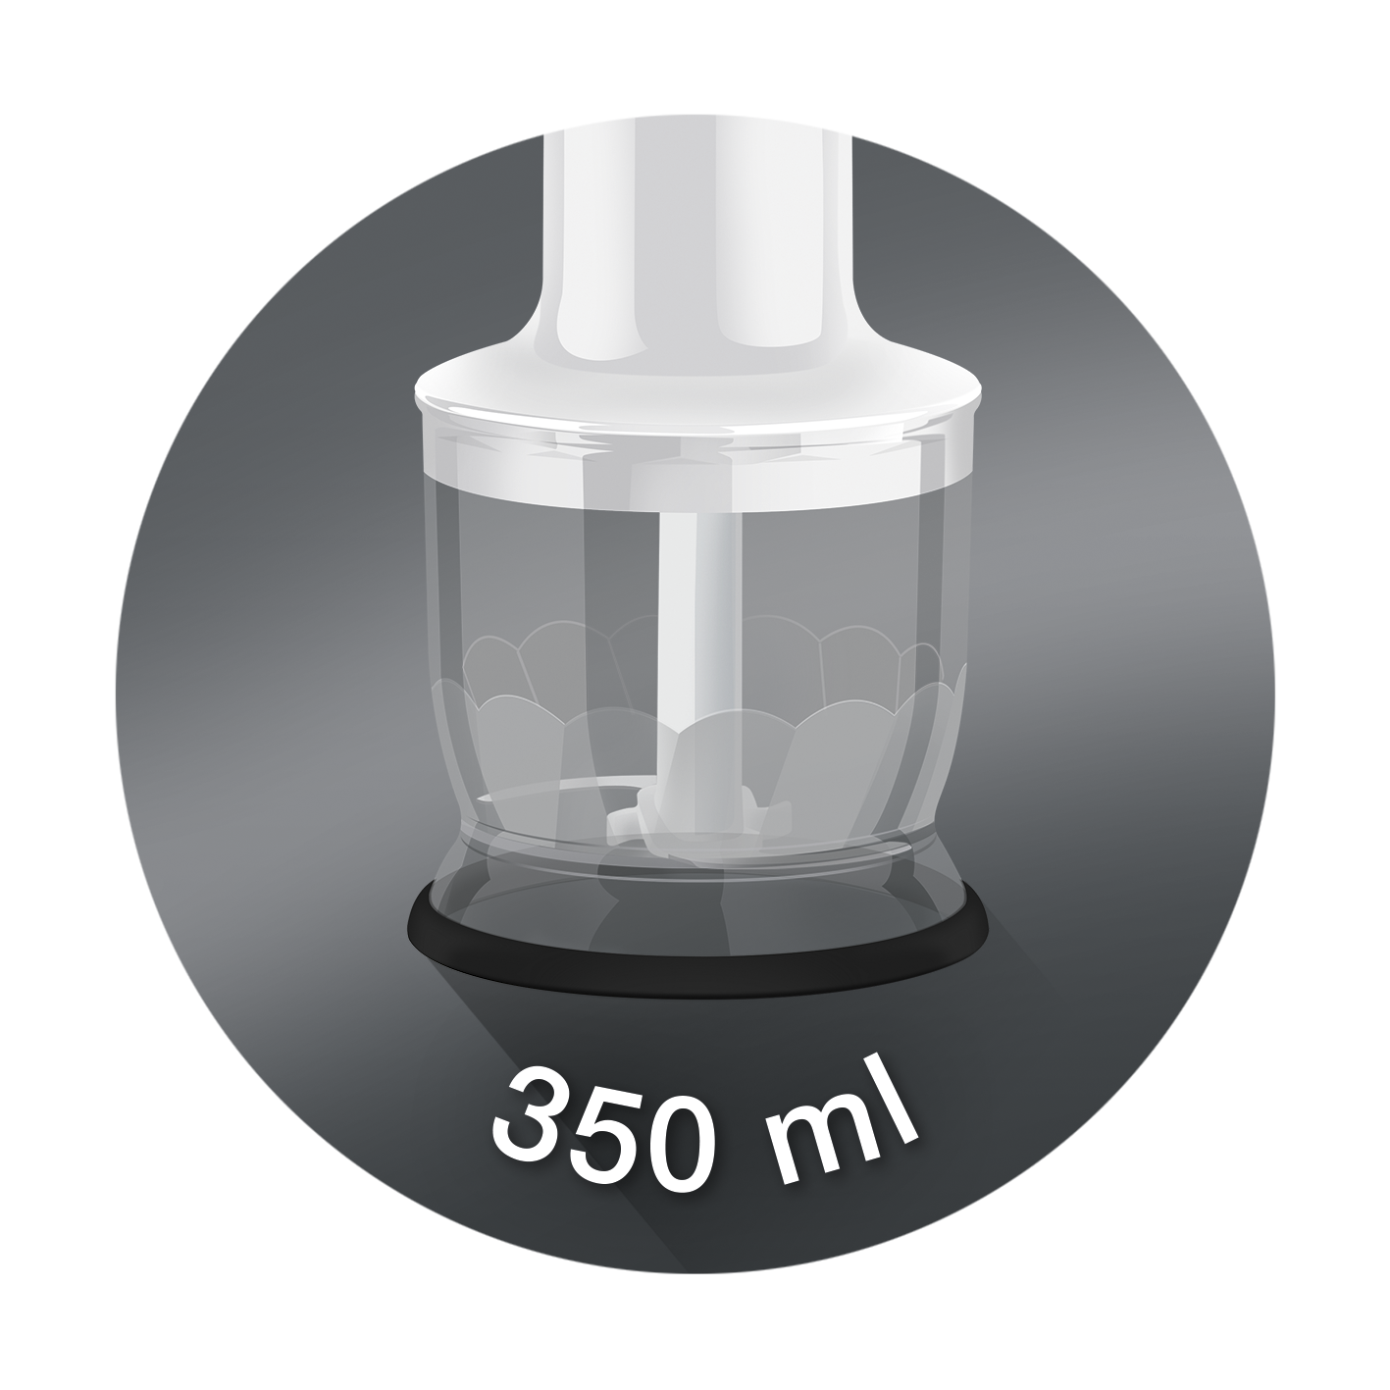
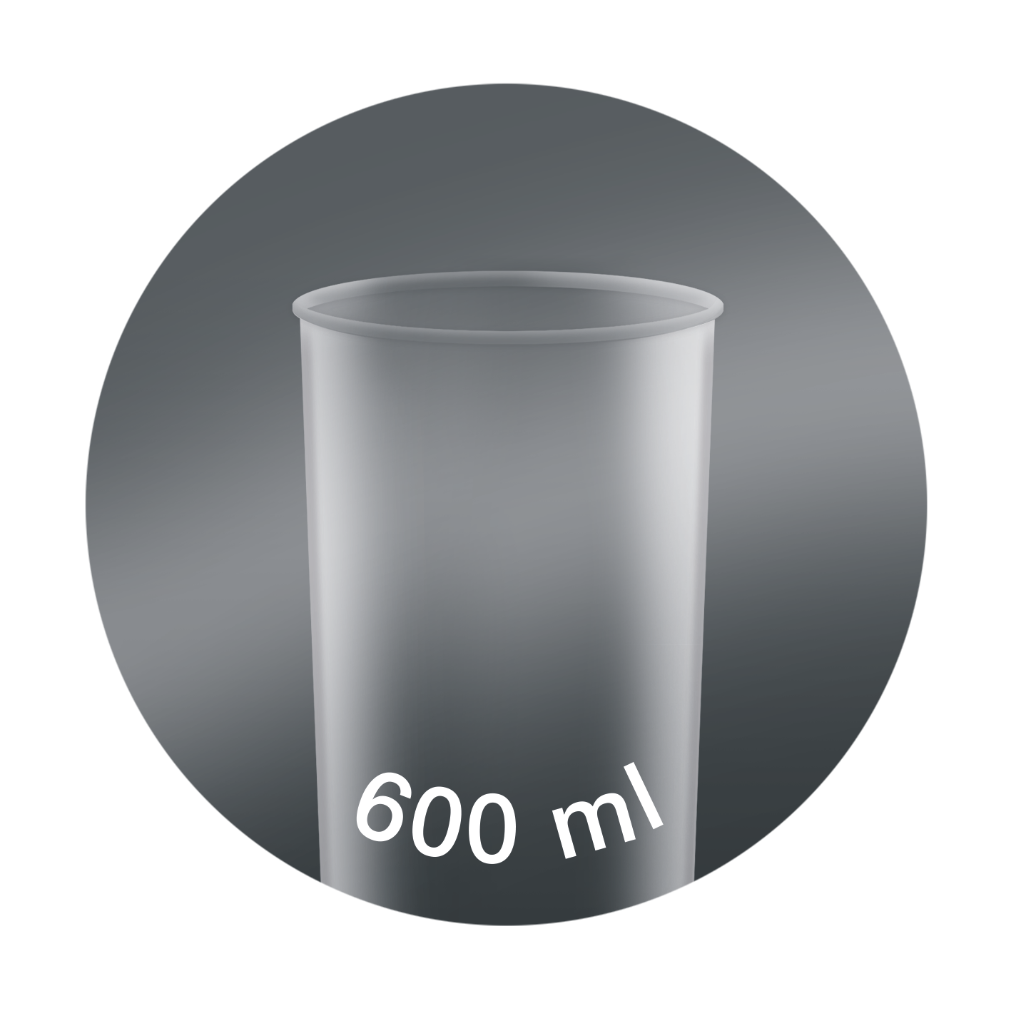
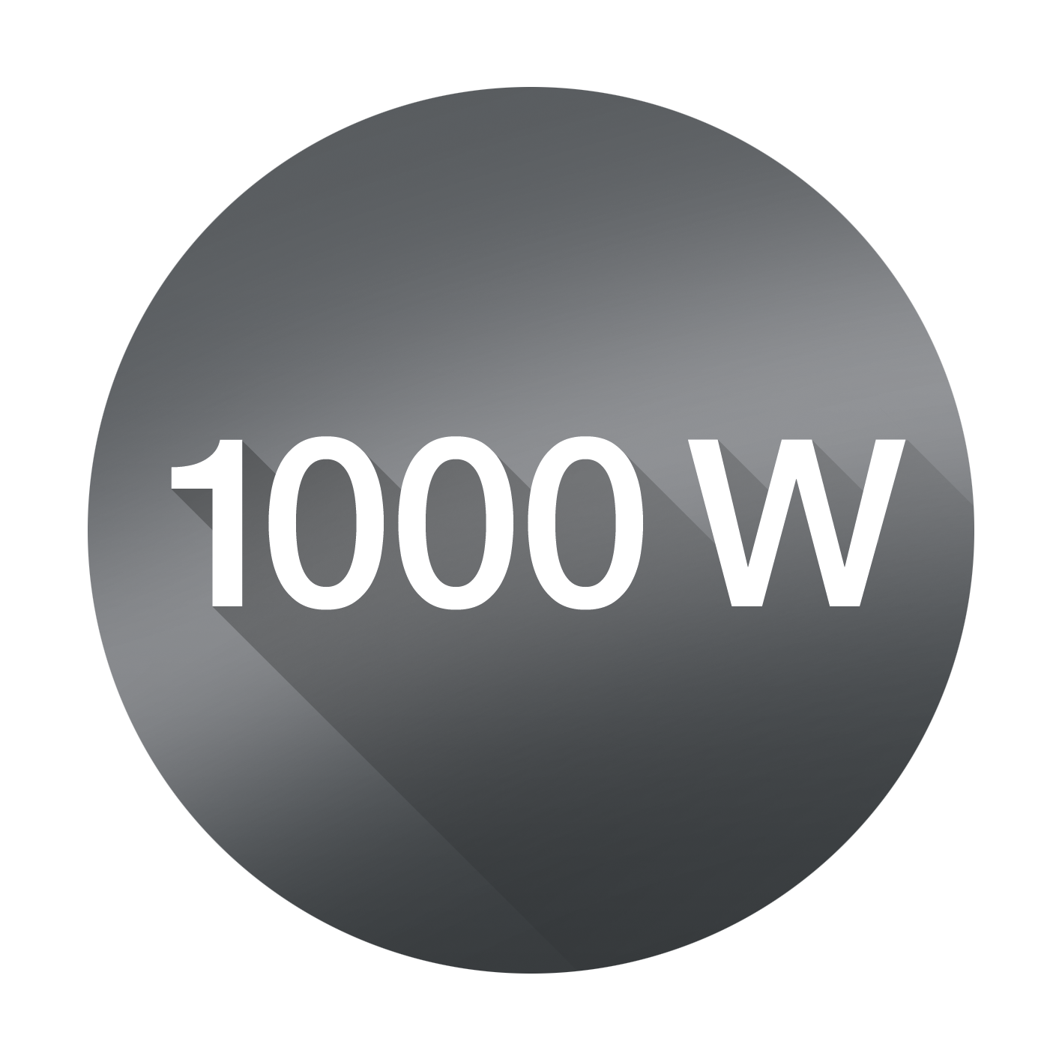
MQ7020
Product highlights
Technical data
Easy SmartSpeed Technology Puts you in control with one touch. 84 % of users think SmartSpeed is more intuitive to use than a traditional speed dial.¹ Simply apply pressure on the control button to adjust the power intuitively and without interruption.
PowerBell VPlus Technology Up to 50% faster performance and 5 times finer results². An extra milling blade and 6 inner ribs create more interaction between food and the blades for great results with less effort.
1000W motor Braun’s powerful 1000W motor.
SPLASHControl technology Prevents splashing – to keep you and your kitchen spotless.
EasyClick system Plus Improved connection to exchange accessories faster and easier. Accessories included:
Chopper Chops hard cheese, nuts, herbs and carrots in seconds.
Beaker 600 ml plastic beaker, BPA free³, with ml and fl oz measurements.
Model | MQ 7020
Type | HB701AI
Colour | premium white/ stainless steel
SKU (INT) | 0X22111421
EAN (INT) | 8021098001313
Power | 1000 W motor
Shaft material | Stainless steel
Dishwasher safe (excluding motor unit and gears) | ●
Soft grip | ●
EasyClick+ connection | ●
Speeds | Easy SmartSpeed
Product dimensions (motor + shaft) | approx. 410 (H) x 55 Ø mm
Product weight (motor + shaft) | approx. 818g
Giftbox dimensions (L x W x H) | approx. 18,7 x 26,1 x 27,6 cm
Giftbox weight (incl. product) | approx. 1,72 kg
Master carton dimensions (L x W x H) | approx. 38,4x 28,6 x 53,8 cm
Master carton weight | approx. 6,45 kg
Accessories include:
Beaker | 600 ml
Chopper | 350 ml
¹ Independent comparison test with 113 users conducted on Braun MQ7 and MQ3Vario in Germany, Mar 2021
² vs. MQ100 on almond milk ³ BPA-free for all parts intended to be in contact with food. Based on third-party testing.
Date of issue: 28-May-21 © 2017 De'Longhi Braun Household GmbH

