Slide 1
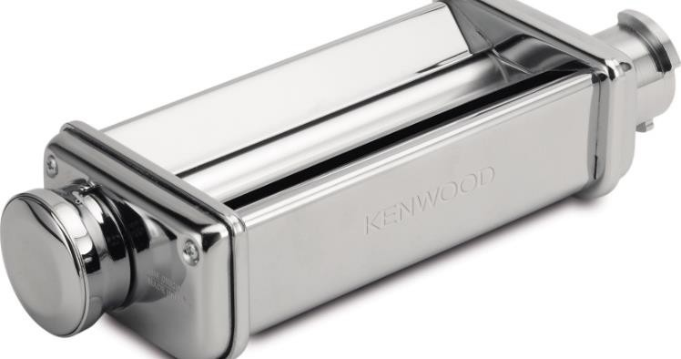
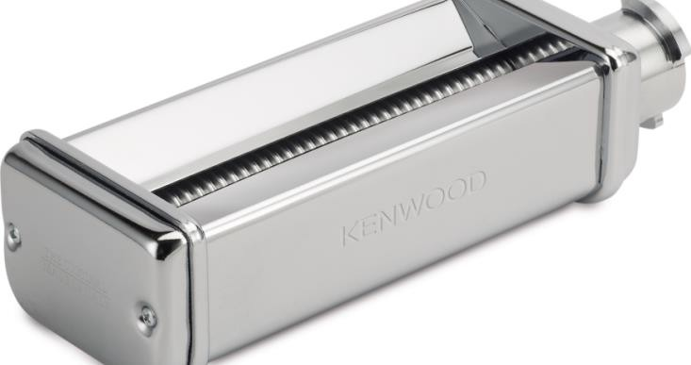
MAX980ME – Lasagne Roller, Fettuccine and Spaghetti Cutters
KM Attachment
The KENWOOD CHEF can be customised by adding a wide range of optional attachments expanding the functionality to perform practically all food preparation tasks. Our high quality attachments have been developed to deliver great, consistent results time after time.
The Kenwood Pasta Cutters have been engineered to effortlessly produce classic Italian pasta dishes using the freshest ingredients.
Heavy duty stainless steel body
Highly durable and excellent for large quantities
Adjustable control dial – Lasagne Roller
10 variable thickness settings
Easy clean
Integral side rings, to eliminate
flour and pasta entrapment for
easy cleanability
Compatibility
KAX980ME – Twist Fit attachment
For Chef and kMix ranges
Multipack
Lasagne Roller
KAX980ME
Fettuccine – 6.5mm width
KAX981ME
Spaghetti – 2mm width
KAX984ME

Slide 2
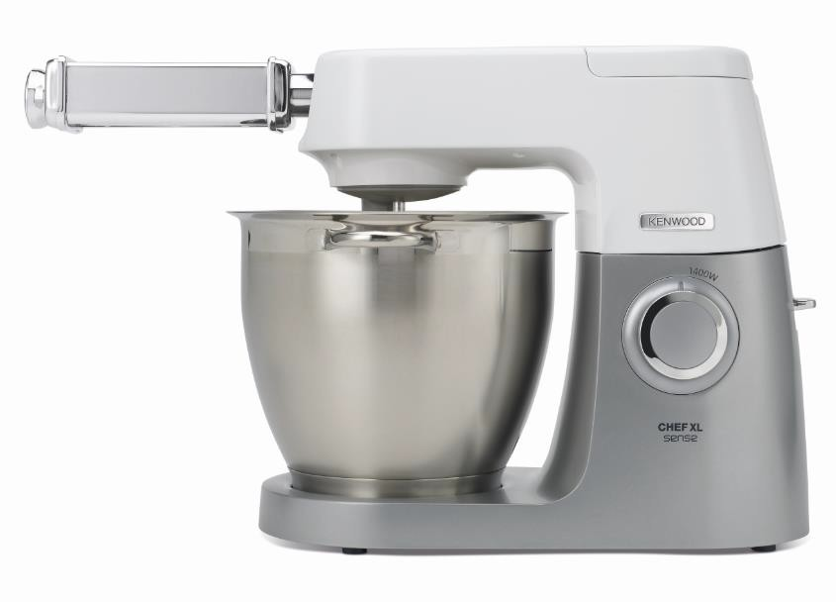
KM Attachment
Product Details
Colour | Silver
Materials | Stainless Steel
MAX980ME – Lasagne Roller, Fettuccine and Spaghetti Cutters
 | Packaging | Single Pack | Multi Pack
MAX980ME | Size (cm) | 26.3L x 16.1W x 7.8H | 27.5L x 16.5W x 26.5H
 | Weight (kg) | 3.48 | 7.16
MOQ | PCS
MAX980ME | 1000
SKU | Description | Barcode
AW20011034 | KAX980ME ATT KW LASAGNE ROLLER INT | Single Pack | 5011423197074
 |  | Multipack | 85011423197469
AW20011031 | KAX981ME ATT KW FETTUCCINE INT | Single Pack | 5011423197043
 |  | Multipack | 85011423197452
AW20011032 | KAX984ME ATT KW SPAGHETTI INT | Single Pack | 5011423197050
 |  | Multipack | 85011423197490
AW20011036 | MAX980ME ATT (multipack including, KAX980ME, KAX981ME and KAX984ME) | Single Pack | 5011423197241
 |  | Multipack | 25011423197481

