Slide 1
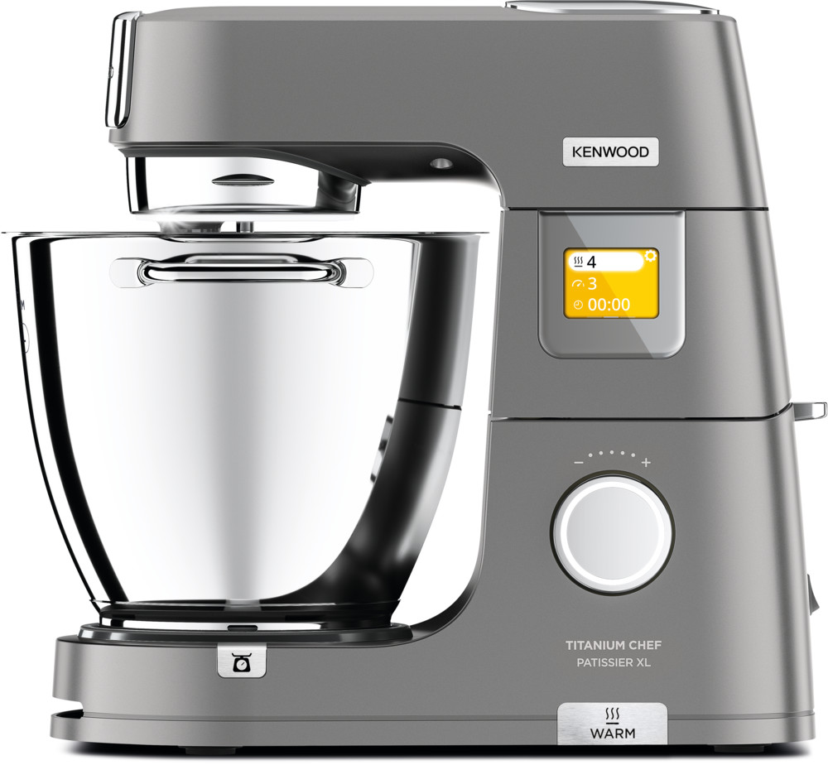
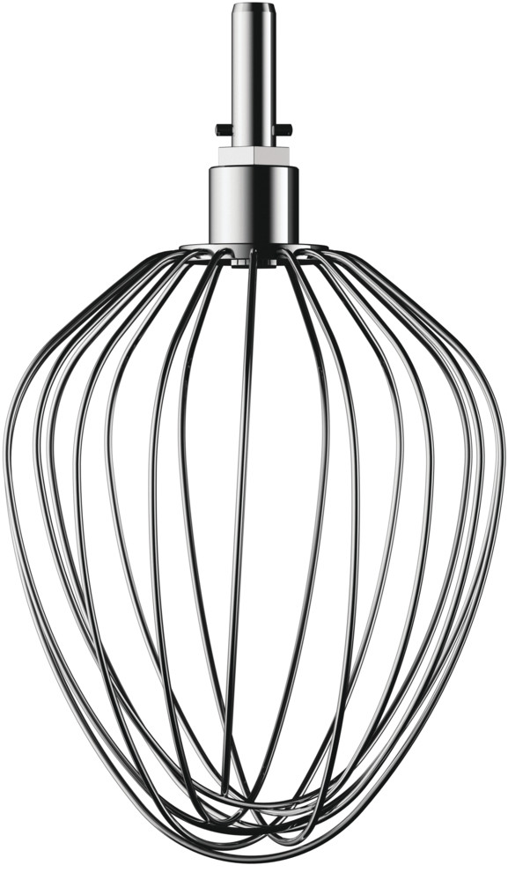
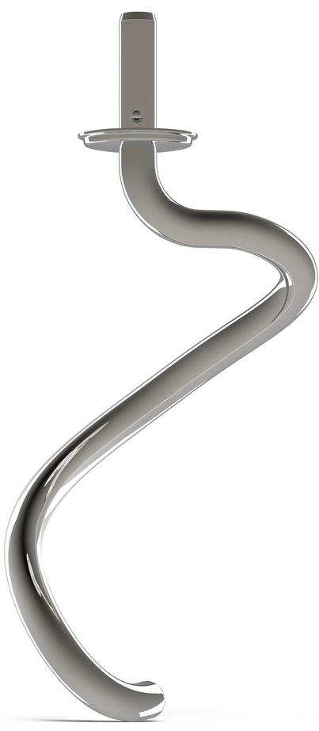
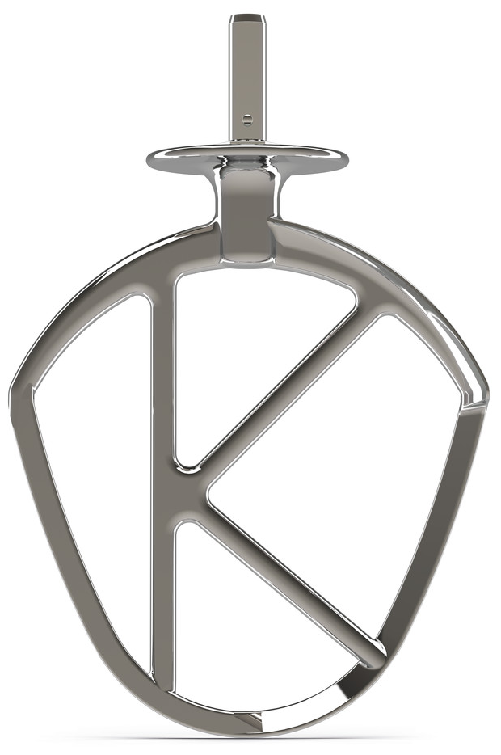
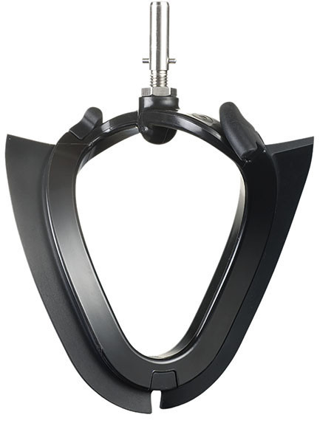
KWL90. – Titanium Chef Patissier XL
1400W
Planetary mix action – maintains speed & power, even under heavy loads
13 speeds
Including the NEW Pulse and Fold function and NEW 3 stir interval speeds
7L & 5L bowl capacity
Large capacity, elegantly flared polished stainless steel with handles
Splash guard
2-piece style with large pour chute – easily fitted
Head release
Spine lever and head-lift interlock for safety
4 bowl tools
Stainless Steel Whisk, Dough Tool, K-Beater and Creaming Beater
Bowl bundle
Comes with 7L and 5L stainless steel nesting bowls as standard
Intuitive full colour touch-screen
Offering expertly crafted pre-set functions
In-bowl warming
Integrated warming; proofs bread, melts chocolate and other ingredients
In-bowl light
Add a touch of brilliance to your baking with in-bowl illumination
Integrated in-bowl weighing
Weighing directly into the bowl saves you time and means less dirty dishes
Asset Bank ID: 191318

Slide 2
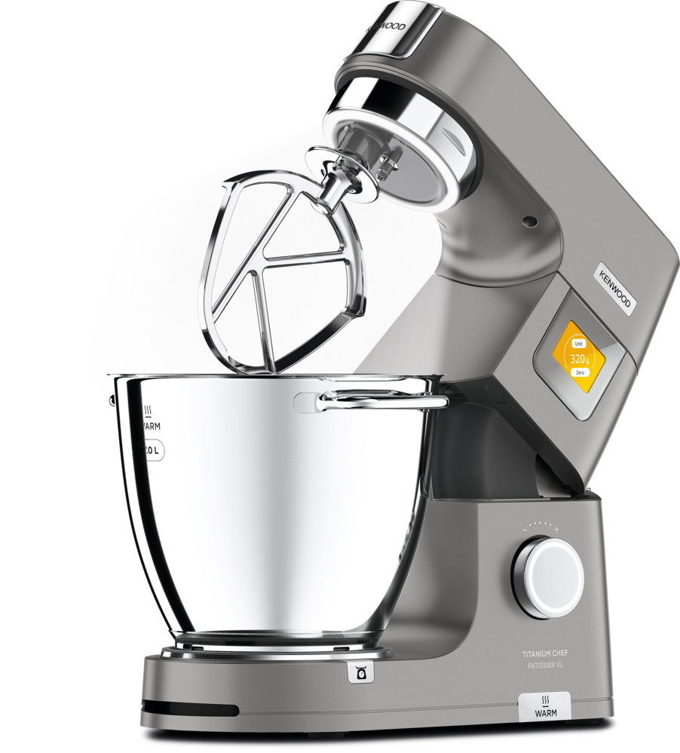
KWL90. – Titanium Chef Patissier XL
Product Details
Colour | Silver
Materials | Die Cast Metal
Dimensions (cm) LxWxH | 39.5 x 20 x 38.5 (without bowl)
Weight (kg) | 9.9 (with 7L bowl), 9.3 (with 5L bowl), 8.5 (with no bowl)
Packaging | KWL90.004SI | KWL90.124SI | KWL90.034SI | KWL90.244SI | KWL90.594SI
Size (cm) | 48.5 x 35 x 49 | 68.5 x 36 x 49 | 68.5 x 36 x 49 | 65.5 x 36 x 49 | 57 x 48.5 x 51
Weight (kg) | 14.40 | 17.9 | 17.9 | 17.5 | 23.3
Container Qty | 20ft | 40ft | 40ft H | MOQ
KWL90.004SI - 0W20011359 | 352 | 720 | 785 | 1,000
KWL90.124SI - 0W20011363 | 192 | 408 | 510 | 1,000
KWL90.034SI - 0W20011371 | 204 | 408 | 510 | 1,000
KWL90.244SI - 0W20011362 | 204 | 432 | 540 | 1,000
KWL90.594SI - 0W20011364 | 192 | 384 | 480 | 1,000
SKU | Description | Barcode
0W20011359 | KWL90.004SI KM KW INT | 5011423206097
0W20011368 | KWL90.004SI KM KW GB | 5011423000015
0W20011371 | KWL90.034SI KM KW + GBL NO D/BWL INT | 5011423001159
0W20011363 | KWL90.124SI KM KW + GBL INT | 5011423206158
0W20011362 | KWL90.244SI KM KW + FP INT | 5011423206141
0W20011364 | KWL90.594SI KM KW +GBL+FP+MG INT | 5011423206165
Asset Bank ID:191316

