Slide 1
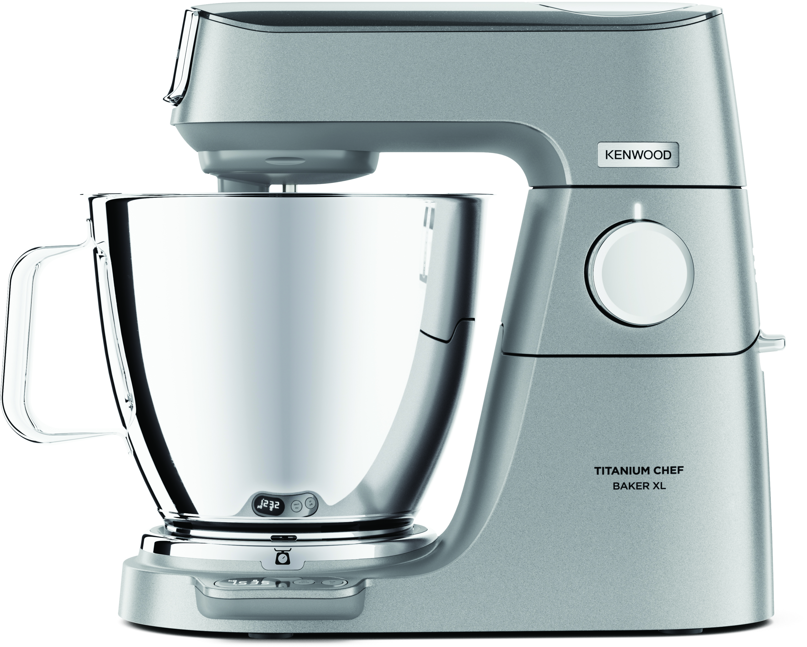
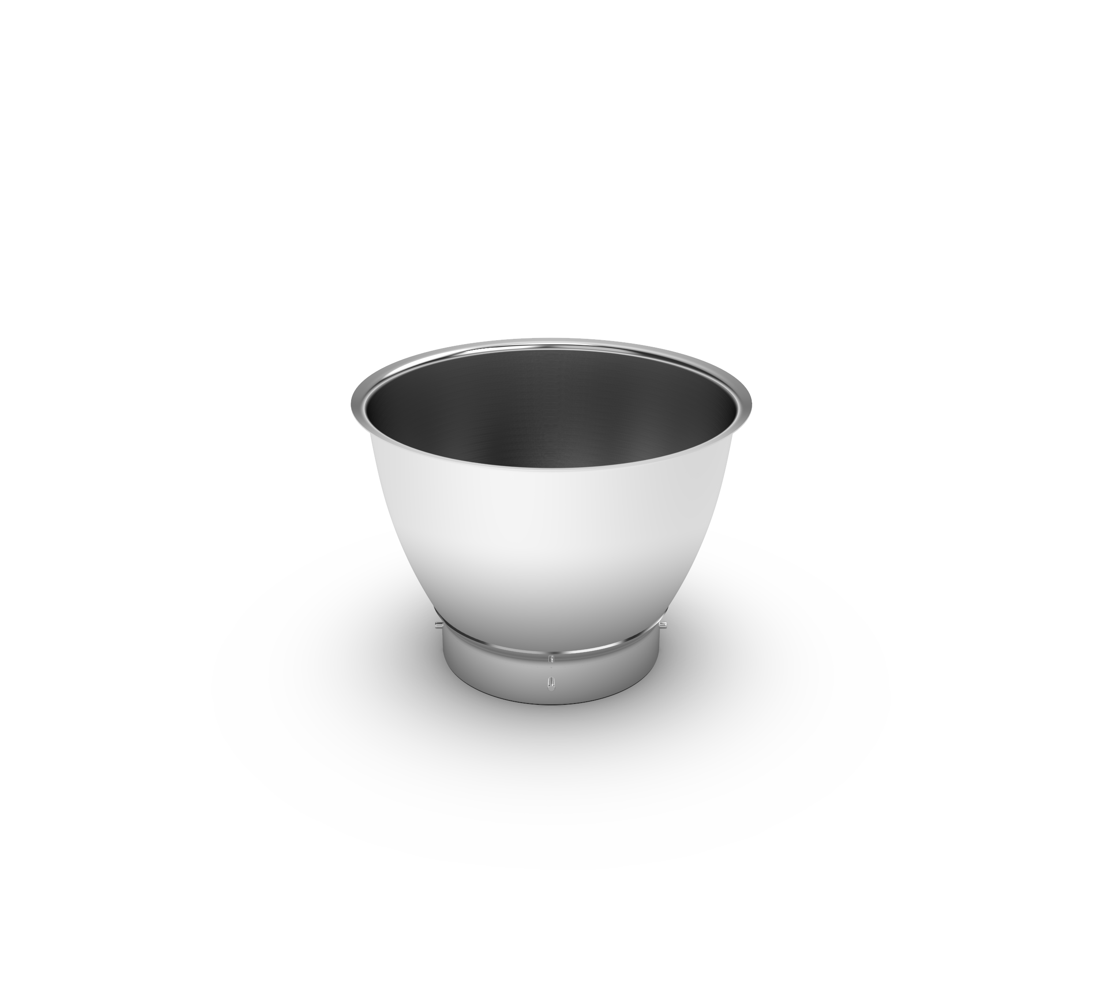
Titanium Chef Baker XL Features – KVL85.
+25 Optional Attachments
ChefMotor™
EasyClean Tools
& Creaming Beater
LightLift™ Head
EasyWeigh Scales
and Timer
Nesting DuoBowl

Slide 2
Titanium Chef Baker XL – KVL85.
Product Details
Colour | Silver
Materials | Die Cast Metal
Dimensions (cm) LxWxH | 40 x 22.5 x 37
Weight (kg) | 11.50, 13.71 (with GBL) 15.30 (with GLB +MG), 16.16 (with GBL + FP), 17.19(with GBL + FP + MG), 20.68 (with GBL+FP+MG+MM+CP)
Packaging | KVL85.004SI | KVL85.124SI | KVL85.224SI | KVL85.424SI | KVL85.594SI | KVL85.704SI
Size (cm) | 53 x 35 x 49.5 | 73 x 35 x 49.50 | 74 x 35 x 49.50 | 80.50 x 35 x 49.50 | 94.50 x 35 x 49.50 | 94.50 x 35 x 49.50
Weight (kg) | 14.91kg | 18.41 | 20.52 | 21.54 | 23.67 | 27.70
Container Qty | 20ft | 40ft | 40ft H | MOQ
KVL85.004SI - 0W20011377 | 284 | 572 | 715 | 1000
KVL85.124SI – 0W20011385 | 192 | 396 | 495 | 1000
KVL85.224SI – 0W20011386 | 192 | 396 | 495 | 1000
KVL85.424SI – 0W20011387 | 184 | 376 | 470 | 1000
KVL85.594SI – 0W20011388 | 152 | 312 | 390 | 1000
KVL85.704SI – 0W20011389 | 152 | 312 | 390 | 1000
SKU | Description | Barcode
0W20011377 | KVL85.004SI KM KW INT | 5011423002019
0W20011385 | KVL85.124SI KM KW GBL INT | 5011423002354
0W20011386 | KVL85.224SI KM KW GBL+MG INT | 5011423002361
0W20011387 | KVL85.424SI KM KW GBL+FP INT | 5011423002378
0W20011388 | KVL85.594SI KM KW GBL+FP+MG INT | 5011423002385
0W20011389 | KVL85.704SI KM KW GBL+FP+MG+MM+CP INT | 5011423002392

