Slide 1
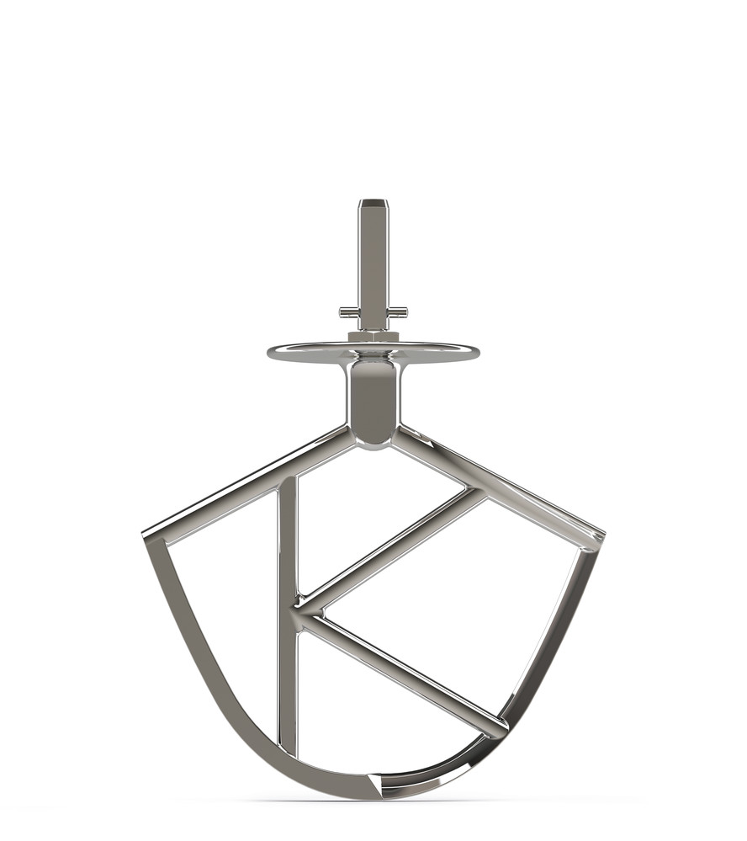
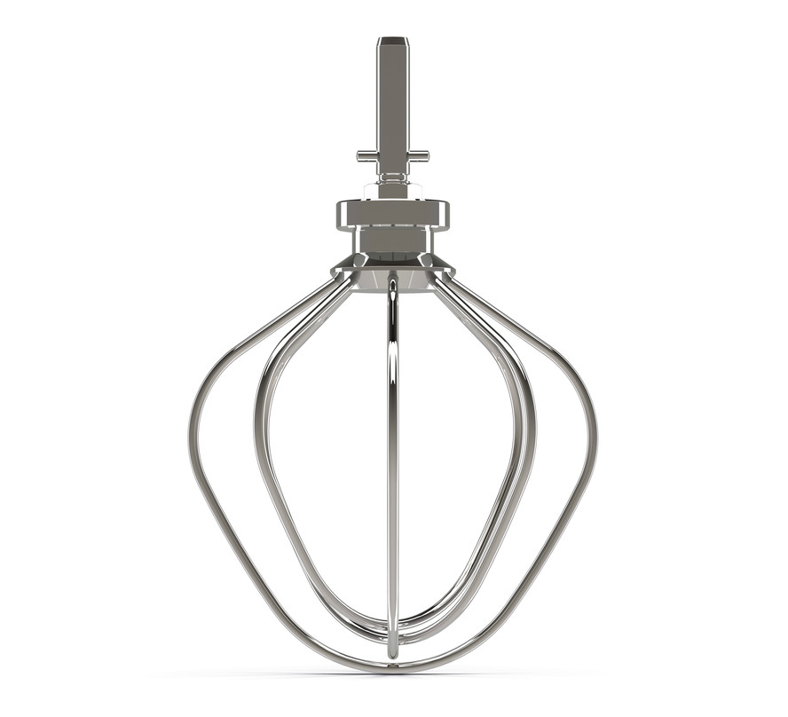
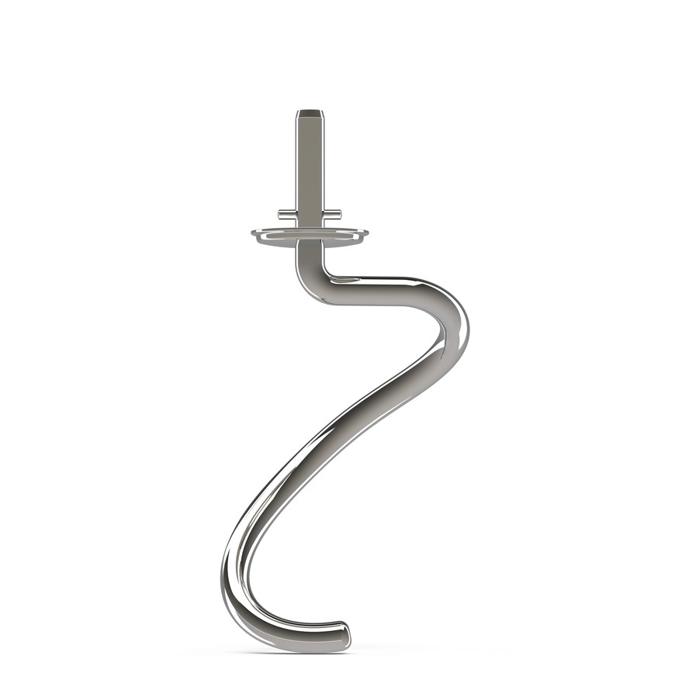
KPL9000S – Pro Kitchen Machine
Professional Kitchen Machine with safety start stop buttons and a fixed finger guard
1700W
Maintains speed and power even under heavy loads
6.7L mixing bowl
Large capacity, stainless steel with handles
3 stainless steel SYSTEMPRO bowl tools
Flat K-beater
Power Whisk
Spiral Dough hook
Electronic speed control
High and slow speed outlet + pulse + fold function
Fixed stainless steel finger guard
Hex slow speed outlet
Compatible with KAX models, adapter required for AT slow speed attachment models

Slide 2
Product Details
Colour | Silver
Materials | Die-cast aluminium
Dimensions (cm) | 34H x 39W x 24D cm
Weight (kg) | 9.8kg
KPL9000S – Pro Kitchen Machine
 | Packaging | Single Pack | Multi Pack
KPL9000S | Size (cm) | 49H x 52W x 30D | NA
 | Weight (kg) | 12.10kg | NA
Container Qty | 20ft | 40ft | 40ft H | MOQ
KPL9000S | 328 | 672 | 940 | 100
SKU | Description | Barcode
0W20011276 | KPL9000S KM KW PRO 3TOOL INT | 5011423196091
Carton sizes, weights and barcodes vary depending on pack contents

