Slide 1
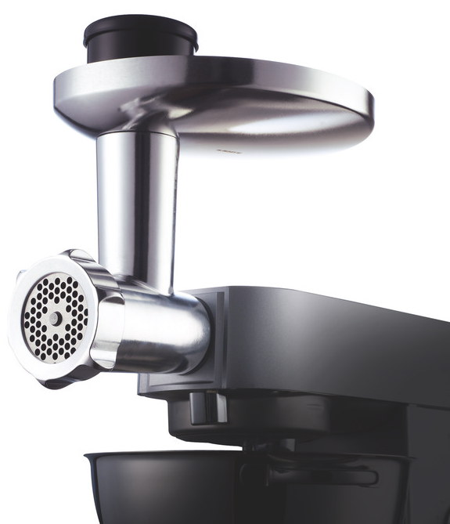
AT950 & KAX950ME – Food Mincer
KM Attachment
The KENWOOD CHEF can be customised by adding a wide range of optional attachments expanding the functionality to perform practically all food preparation tasks. Our high quality attachments have been developed to deliver, good consistent results time after time.
The Food Mincer is a high performance meat grinder allows preparation of a huge variety of dishes from home using three inclusive screens.
High performance
Allows for preparation of a huge variety of dishes from burgers, lasagne, meat and pies
All metal body and scroll
For high quality results even with the toughest meats
3 screens included
Coarse
Medium
Fine
Versatility
Can grind a variety of meats such as beef, chicken, duck, fish and rabbit
Includes
Sausage maker for fresh, healthy homemade sausages and kebbe maker for specialist dishes
Includes
Kebbe maker for specialist dishes
Compatibility
AT950 - Bar Fit attachment
Chef and Major Kitchen Machines
KAX950ME – Twist Fit Attachment
Chef Sense, Chef Sense XL Kitchen Machines
kMix Stand mixers

Slide 2
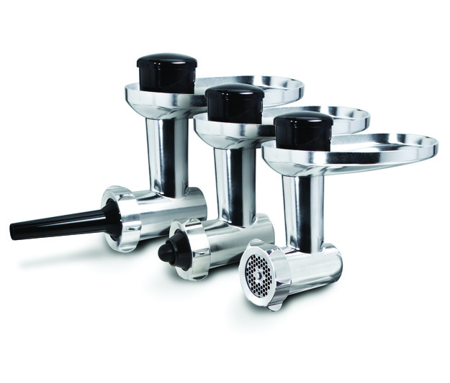
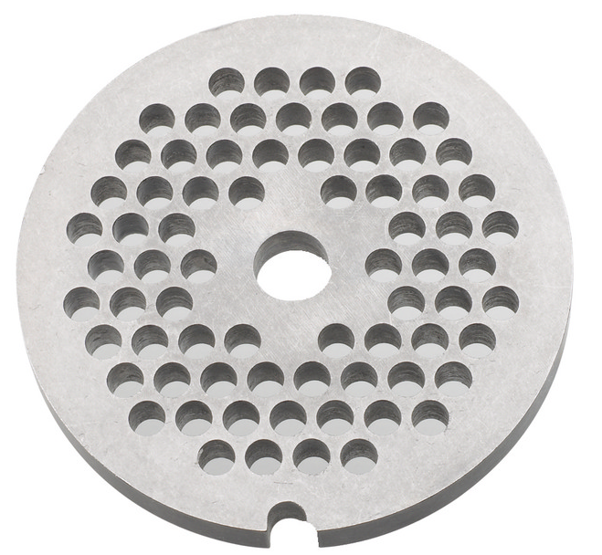
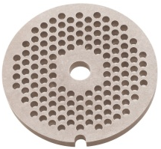
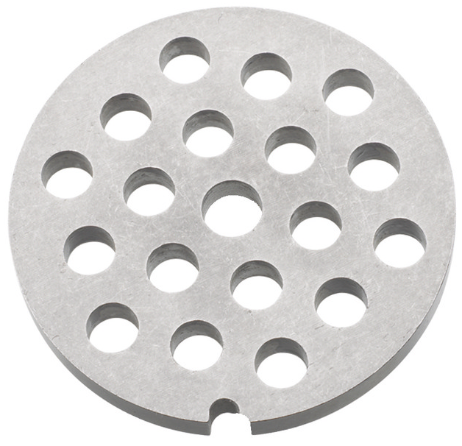
KM Attachment
Product Details
Colour | Silver
Materials | Aluminium Body
Dimensions | 18H x 30W x 19D cm
Weight | 1.8kg
AT950 & KAX950ME – Food Mincer
Packaging | Single Pack | Multi Pack
Size cm | 25.8H x 20.7W x 16.9D | 28.5H x 35.6W x 22D
Weight | 2.1kg | 4.7kg
Container Qty | 20ft | 40ft | 40ft H | MOQ
 | 2560 | 5280 | 5940 | 100pcs
SKU | Description | Barcode
AWAT950B01 | AT950A MINCER ALU/BLACK 2PCM INT | Single Pack | 5011423103617
 |  | Multi Pack | 25011423142658
AW20011012 | KAX950ME AT KW MULTI FOOD GRINDER | Single Pack | 5011423176987
 |  | Multi Pack | 25011423177254

