Slide 1
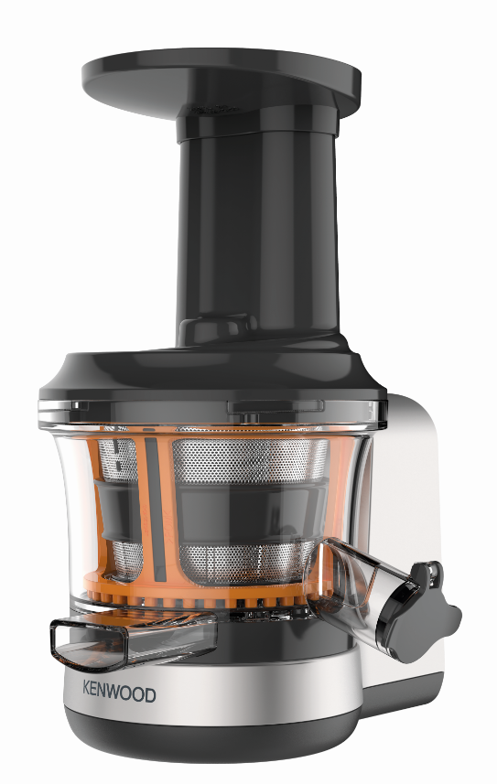
KAX720PL – PureJuice Attachment
Fitting the slow speed outlet of all Chef* and kMix kitchen machines the new Kenwood PureJuice Attachment provides an easy way to get your much needed vitamin intake and recommended five a day.
New Slow Scroll Juicer
For a smooth nutritious drink
Twist Fit Attachment
Fits both kMix and Kenwood Chef ranges
Juice Jug
400ml of fresh juice (1L Air Capacity)
Pulp Extractor
To enable you to collect the fibrous pulp that can be used in cakes, brownies, falafels or adding to soups.
No Drips!
Anti-drip stopper for no spillages or drips
Cleaning brush.
Safety interlock
Please note: Not compatible with Chef XL Pro KPL9000S

Slide 2
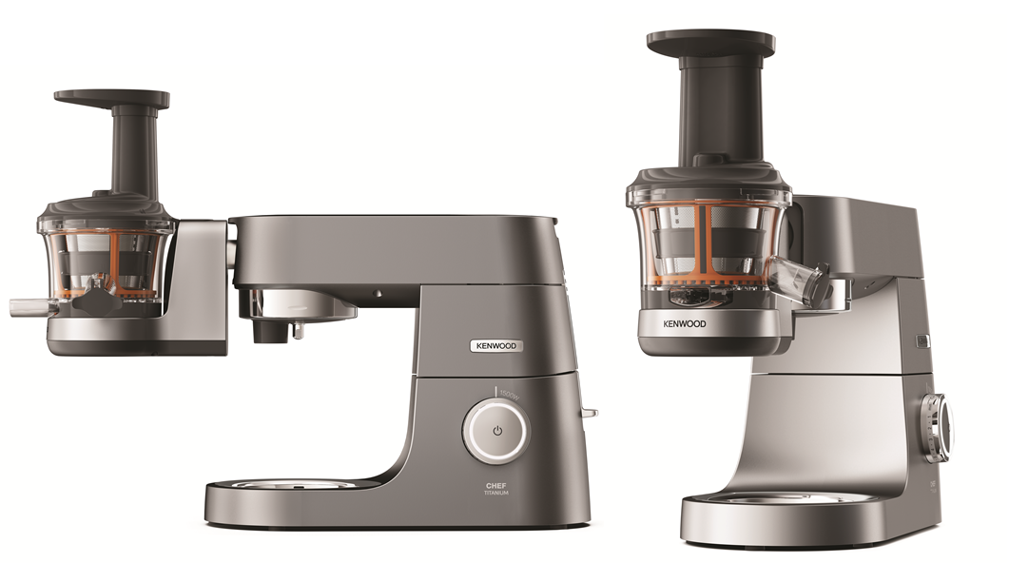
KAX720PL PureJuice Attachment
Product Details
Colour | Silver and Grey
Materials | Plastic
Dimensions (cm) | 27L X 22W x 27H
Weight (kg) | 2.57kg
 | Packaging | Single Pack | Multi Pack
 | Size (cm) | 30L x 30W x 21H | 63L x 31.8W x 45H
 | Weight (kg) | 3.17kg | 14.4ikg
Container Qty | 20ft | 40ft | 40ft H | MOQ
 | 1252 | 2576 | 2948 | 2576
SKU | Description | Barcode
AW20010016 | KAX720PL Scroll Juicer Attachment | Single Pack | TBC
 |  | Multi Pack

