Slide 1
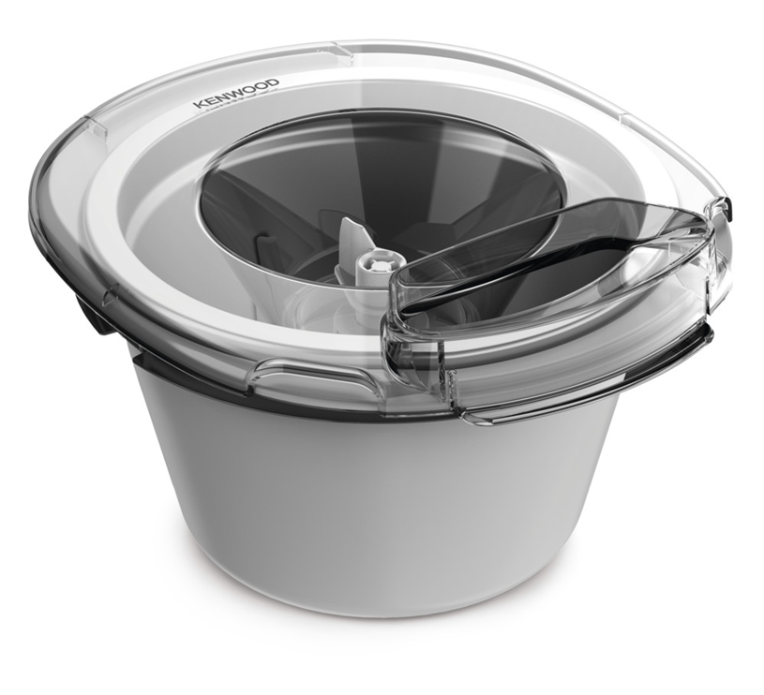
KAX71.000WH - Frozen Dessert Maker Make Frozen Desserts in 30 minutes!
Makes ice cream in 30 minutes – The improved paddle moves ingredients around the bowl and freezes the ingredients within 30 minutes while minimising ice particles.
Up to 1L of delicious frozen desserts –The 1L pre freeze-able bowl for large batches of ice cream, sorbet or frozen yoghurt.
Fits in to a standard freezer drawer - We have tested the bowl to fit in most freezers without any extra effort having to remove a freezer shelf.
Convenient to use and easy to handle – The shape and size of the new Frozen Dessert Maker has been designed to be convenient to use and easy to handle.
Redesigned fitment of the bowl – New design of the bowl enhancing the locking and unlocking experience.
Better Paddle fitment – Better fitment of the ice cream paddle.
Dishwasher Safe – Paddle and Adaptor
Compatible with all current kitchen machines – It fits Chef and Chef XL models including Titanium and Cooking Chef, the current range Titanium, Elite, Sense and Chef, Cooking Chef

Slide 2
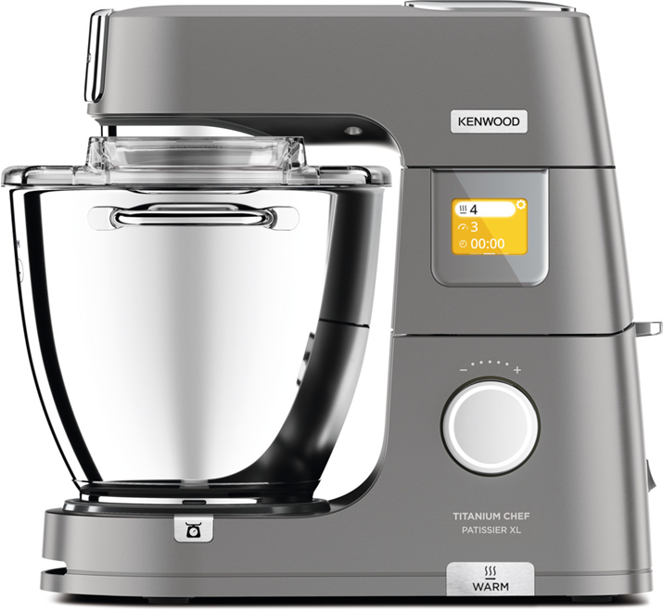
Data Sheet Slide 2
Product Details
Colour | White
Materials | Plastic
Dimensions (cm) LxWxH | 28.71 x 24.29 x 16.37 cm
Weight (kg) | 1.71kg
Packaging | Single Pack | Multi Pack
Size (cm) | 31 x 30 x 18.30 | 62 x 32.5 x 39.30
Weight (kg) | 2.15 | 9.32
Container Qty | 20ft | 40ft | 40ft H | MOQ
 | 1440 | 3040 | 3472 | 4
SKU | Description | Barcode
AW20010022 | KAX71.000WH ATT KW FROZEN DST MAKER INT | Single Pack | 5011423002132
 |  | Multi Pack | 45011423002130
Please contact your Regional Co-Ordinator for samples and SKU information

