Slide 1
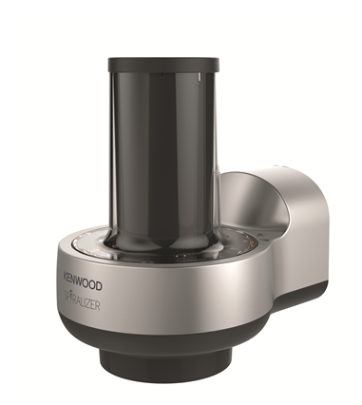





KAX700PL – Spiralizer Attachment.
Fitting the slow speed outlet of all Chef and kMix kitchen machines the new Kenwood Spiralizer Attachment will make eating your five a day seem easy. Turning fruit and vegetables in to a variety of noodles and ribbons it will help you to reinvent classic pasta dishes, salads, entrees and desserts.
Twist Fit Attachment
Pappardelle (Flat blade) Cutting Cone
To create thick ribbons
Linguine Cutting Cone 2 x 4mm
To create thin vegetable style noodles
Spaghetti Cutting Cone 2 x 2mm
To create thin vegetable style noodles
Tagliatelle Cutting Cone 2 x 9mm
To create thick vegetable style noodles
Crinkle Cutting Cone
To create thick crinkled ribbons
Safety interlock
Easy to use
Minimal effort required, quicker and easier compared to manual spiralizers
Dishwasher safe parts
Allowing for easy cleaning

Slide 2
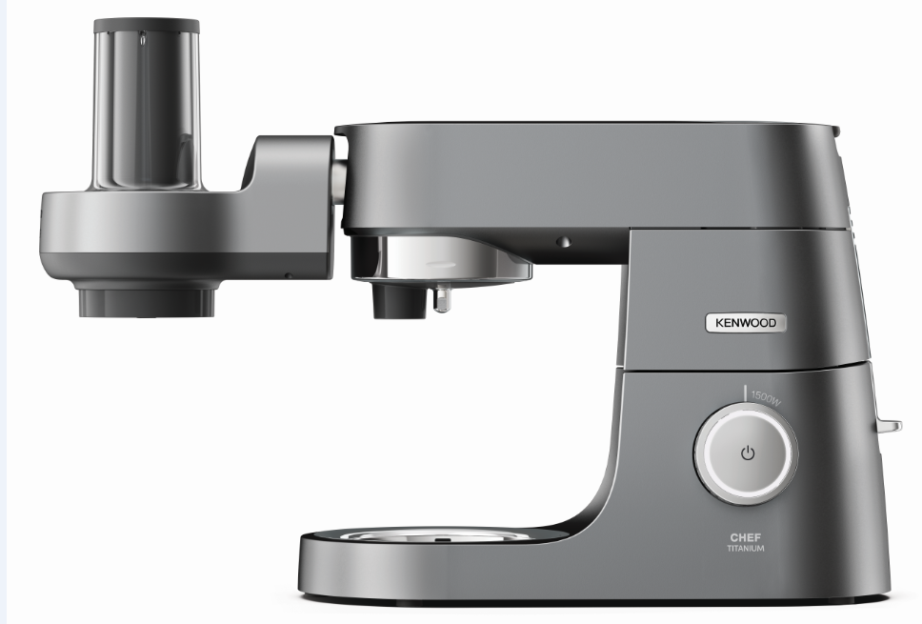
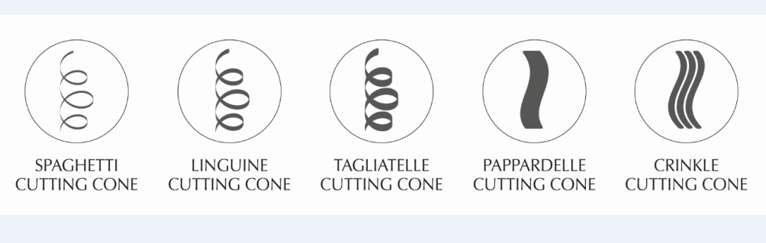
KAX700PL Spiralizer Attachment
Product Details
Colour | Silver and Grey
Materials | Plastic
Dimensions (cm) | 21H x 16W x 22L
Weight (kg) | 1.05kg
 | Packaging | Single Pack | Multi Pack
 | Size (cm) | 39H x 18W x 28L | 41.2H x 37.4W x 57.8L
 | Weight (kg) | 1.88kg | 8.51kg
Container Qty | 20ft | 40ft | 40ft H | MOQ
 | 1296 | 2680 | 3176 | 2680
SKU | Description | Barcode
AW20010015 | KAX700PL Spiralizer Attachment | Single Pack | TBC
 |  | Multi Pack

