Slide 1
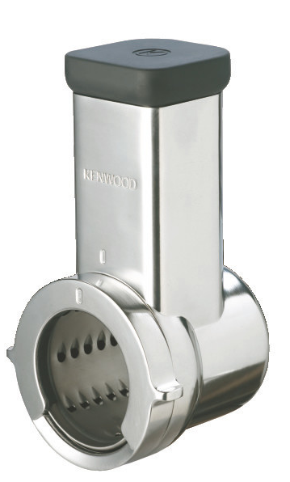
KAX643ME – Roto Food Cutter
Fitting to the slow speed outlet of Chef and kMix machines the Roto Food Cutter will effortlessly slice, shred and rasp a variety of vegetables, nuts and cheese.
High quality traditional slicing, shredding and rasping drums
Slow rotary action for optimum results
Slow Speed Outlet
Fits all Chef/kMix models with twist connection
Continuous Action
As the attachment feeds out over the bowl there is a continuous action for large quantities
Suitable for a variety of foods
Including nuts, cheese and chocolate

Slide 2
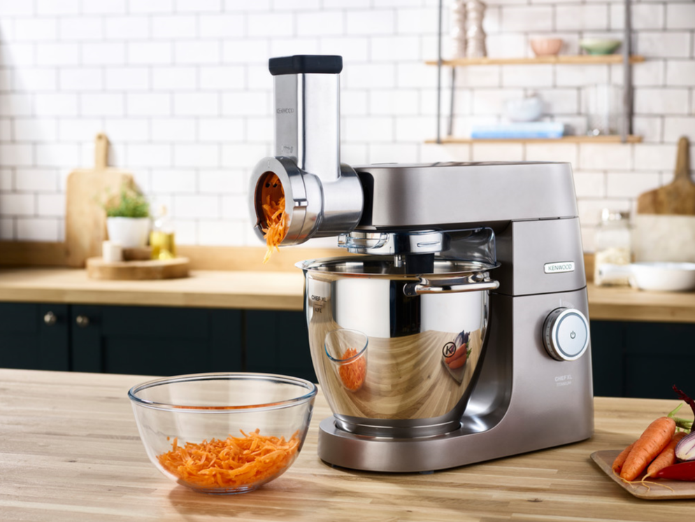
KAX643ME – Roto Food Cutter
Product Details
Colour | Grey
Materials | Stainless Steel and Plastic
Dimensions (cm) | 21.3L x 13.7H x 12W
Weight (kg) | 1.6kg
 | Packaging | Single Pack | Multi Pack
 | Size (cm) | 30L x 17H x 21.3W | 19.5H x 31.2W x 44.5D
 | Weight (kg) | 2.1Kg | 8.8kg
Container Qty | 20ft | 40ft | 40ft H | MOQ
 | 2,110 | 4,290 | 4,956 | 100
SKU | Description | Barcode
AW20011008 | KAX643ME Roto Food Cutter | Single Pack | 5011423176949

