Slide 1
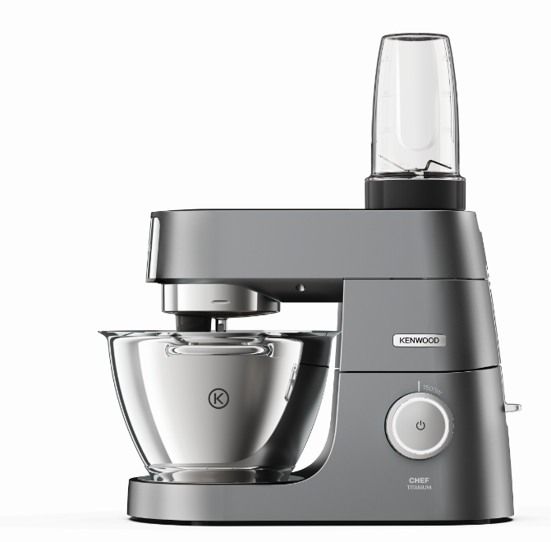
KAH740PL – Blend Xtract Sport Attachment
Fitting the high speed outlet of all Chef kitchen machines the new Kenwood Blend Xtract Sport Attachment is the simple way to enjoy delicious smoothies, juices and milkshakes just the way you like them.
New Smoothie2Go Sport Attachment
For a smooth nutritious drink
High Speed Outlet
Fits all Kenwood Chef
2 x 600ml Tritan Smoothie Goblets
2 x Easy Flip Lids
Stainless Steel Blades
Ergonomically designed to breakdown even the toughest food to a nice, smooth consistency.
Safety interlock

Slide 2
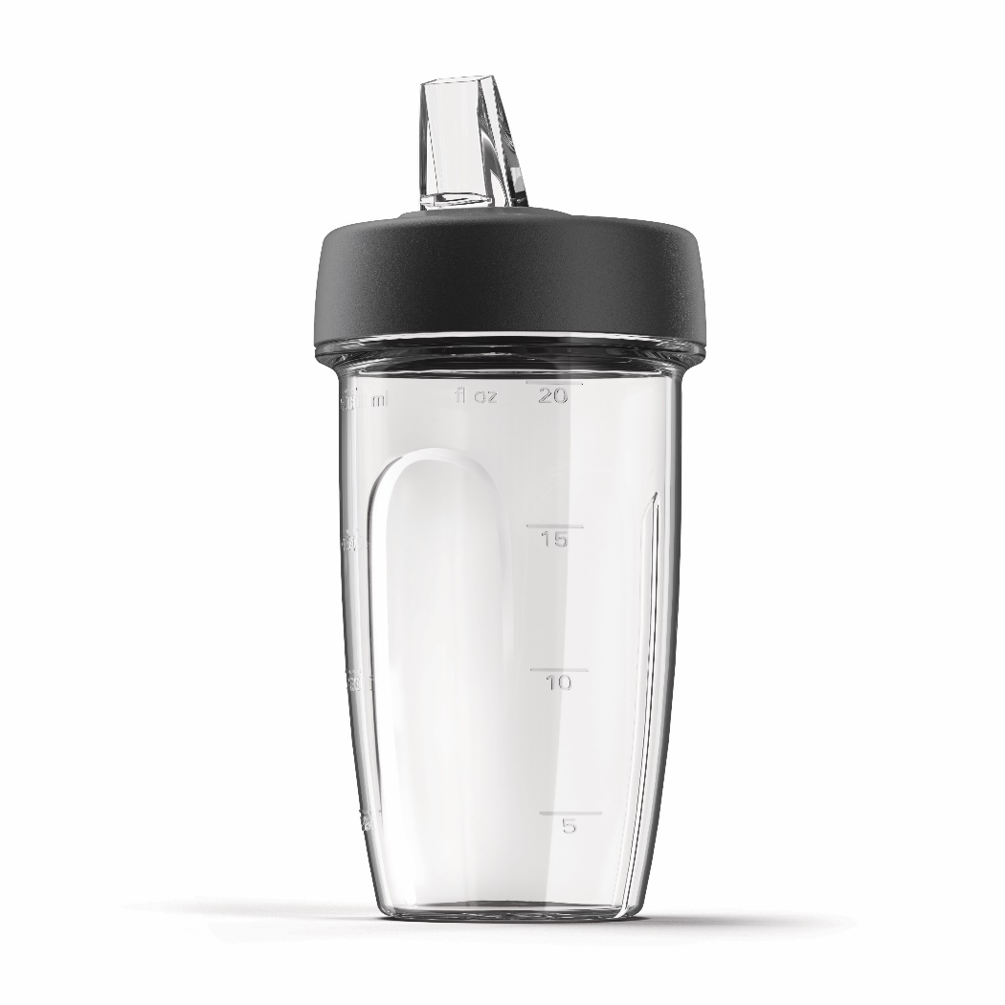
KAH740PL – Blend Xtract Sport Attachment
Product Details
Colour | Grey and Clear
Materials | Plastic
Dimensions (cm) | 9.5L x 9.5W x 20H
Weight (kg) | 0.76kg
 | Packaging | Single Pack | Multi Pack
 | Size (cm) | 25.8L x 13.5W x 25.8H | 64H x 35.8W x 25.8L
 | Weight (kg) | 0.90kg | 4.170kg
Container Qty | 20ft | 40ft | 40ft H | MOQ
 | 837 | 1683 | 1870 | 500
SKU | Description | Barcode
AW20010017 | KAH740PL Blend Xtract Sport Attachment | Single Pack | TBC
 |  | Multi Pack

