Slide 1
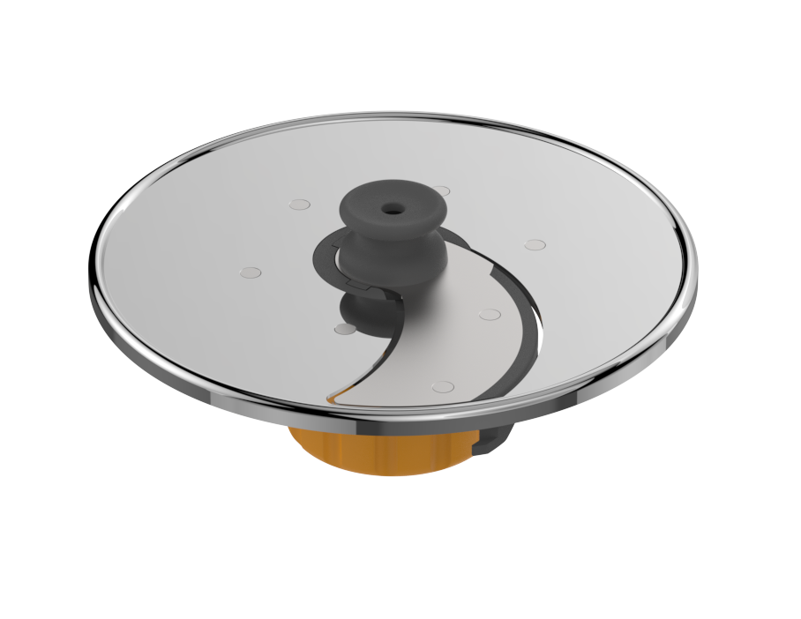
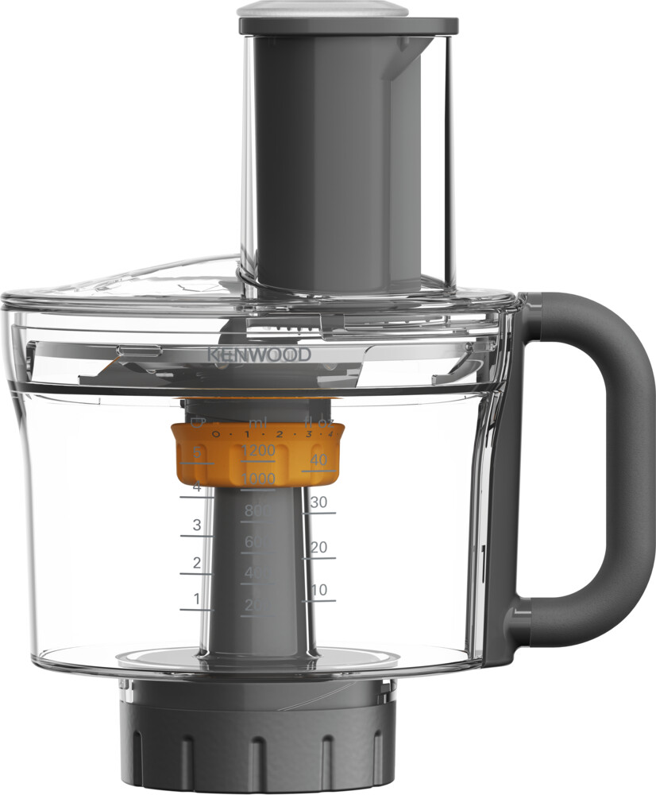
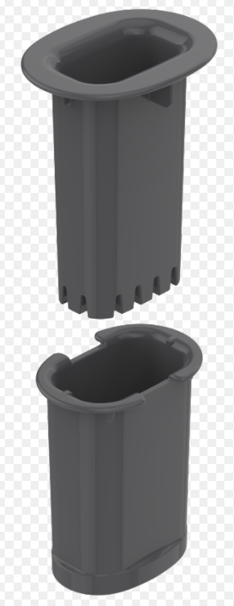

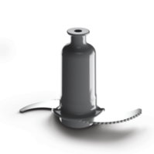

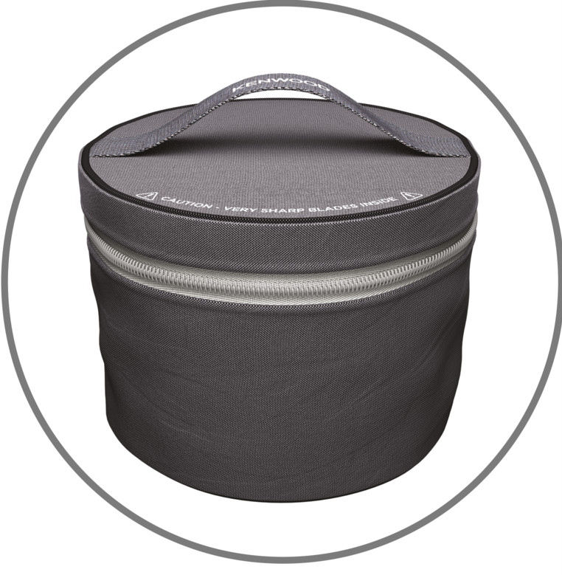

KAH65.000PL - MultiPro Food Processor Attachment
A new and improved food processor that chops, slices, shreds and dices to support you in even more food preparation tasks.
6-in-1 Adjustable Slicing Disc – 1 disc, 6 options; from super fine to extra thick slicing, plus dicing
Express Dice™ – Easy-clean patented Express Dice™ system for dicing, crudités and fries
Shatterproof and durable – Innovative, shatterproof and dishwasher-safe Tritan bowl material designed for continuous use
EverSharp™ chopping blades – Power through ingredients every time with the 10 times longer lasting EverSharp™ chopping blades*
Large capacity – The 1.2L capacity bowl is perfect for larger food preparation or batch cooking
5 discs in pack – 6-in-1 adjustable slicing, extra fine grating, fine grating, coarse grating and julienne
SmartStore™– Keep all your essential tools neatly and safely together in the SmartStore™ bag*
Dishwasher safe – Fully dishwasher safe for a fuss-free clean up
5
*Only when sold as standalone
**vs Kenwood Type FDP30 non-serrated blades

Slide 2
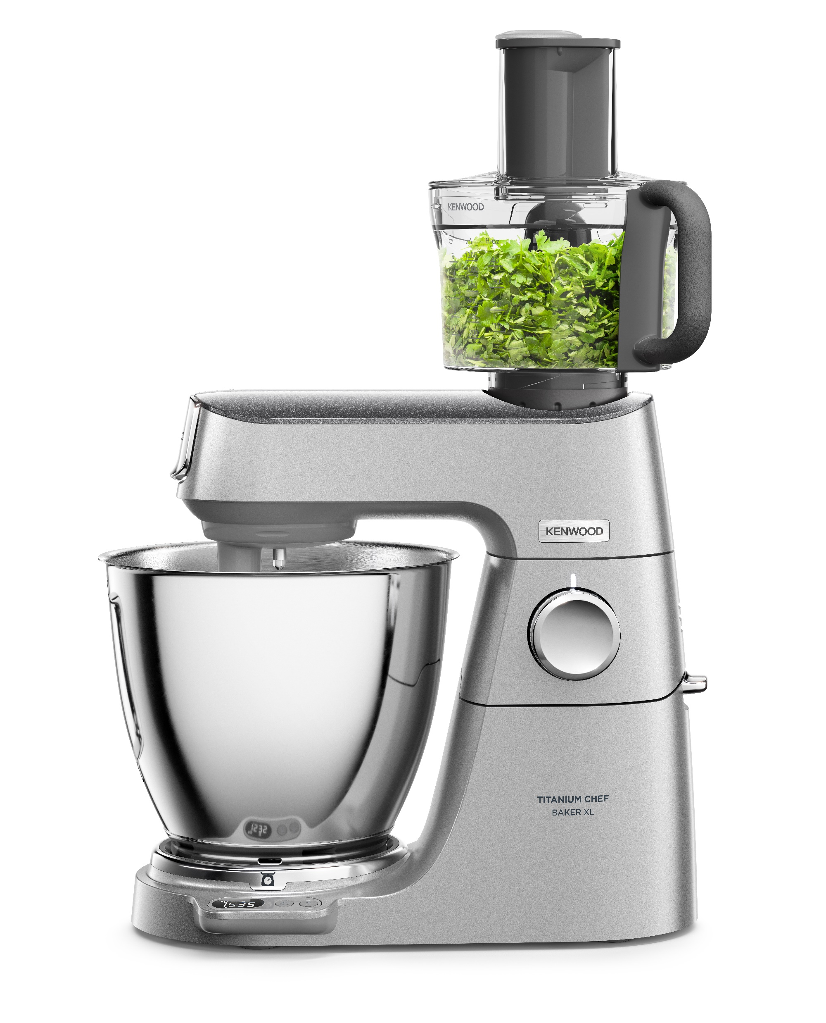
KAH65.000PL - MultiPro Food Processor Attachment
Product Details
Colour | Grey and clear
Materials | TritanTM Plastic
Dimensions (cm) LxWxH | 20.1 (L) x 18.4 (W) x 27.7 (H)
Weight (kg) | 2.36
Packaging | Single Pack | Multi Pack (2 units)
Size (cm) | 34 x 23 x 29 | 48 x 35.5 x 32
Weight (kg) | 3.03 | 6.70
Container Qty | 20ft | 40ft | 40ft H | MOQ
KAH65.000PL | 1080 | 2160 | 2496
SKU | Description | Barcode
AW20010042 | KAH65.000PL ATT KW MULTIPRO FP INT | Single Pack | 5011423005447
 |  | Multi Pack (2 units) | 25011423005441

