Slide 1
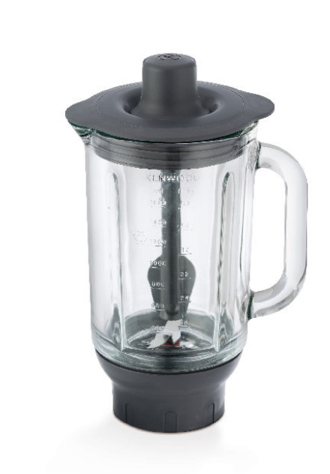
KAH359GL – ThermoResist Glass Blender
Fitting the high speed outlet of all Chef kitchen machines the Kenwood ThermoResist glass blender is perfect for blending hot liquids and soups and well as cold recipes.
Unique multizone blade
For best all round performance, ideal for blending and pureeing to a smooth texture
ThermoResist glass goblet
Heat resistant for blending hot ingredients
Cold blending capacity of 1.6 litres
For smoothies and other cold recipes
Hot blending capacity of 1.2 litres
For soups and other hot recipes
Suitable for all current machines
Fits all Chef, Major, Chef Sense, Chef XL Sense and Cooking Chef Machines
Durable and dishwasher safe
With removable, easy clean stainless steel blades
Stir Stick (KAH359GL only)
For maximum mixing efficiency, especially for thick recipes like smoothies

Slide 2
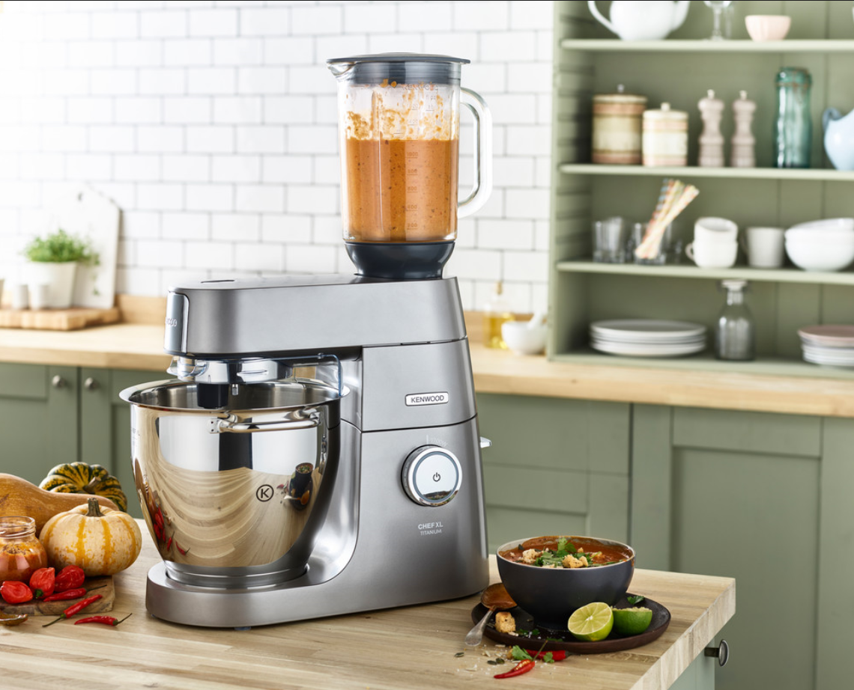
KAH359GL – Thermoresist Glass Blender
Product Details
Colour | Grey
Materials | Borosilicate glass and plastic
Dimensions (cm) | 14L x 19.5W x 26.5H
Weight (kg) | 0.76kg
 | Packaging | Single Pack | Multi Pack
 | Size (cm) | 19.8L x 30.5W x 19.8H | 28L x 31.7W x 27H
 | Weight (kg) | 2.8kg | 6.2kg
Container Qty | 20ft | 40ft | 40ft H | MOQ
KAH359GL | 1690 | 3470 | 3930 | 100
SKU | Description | Barcode
AW22000005 | KAH359GL TBL KW INT | Single Pack | 5011423199368

