Slide 1
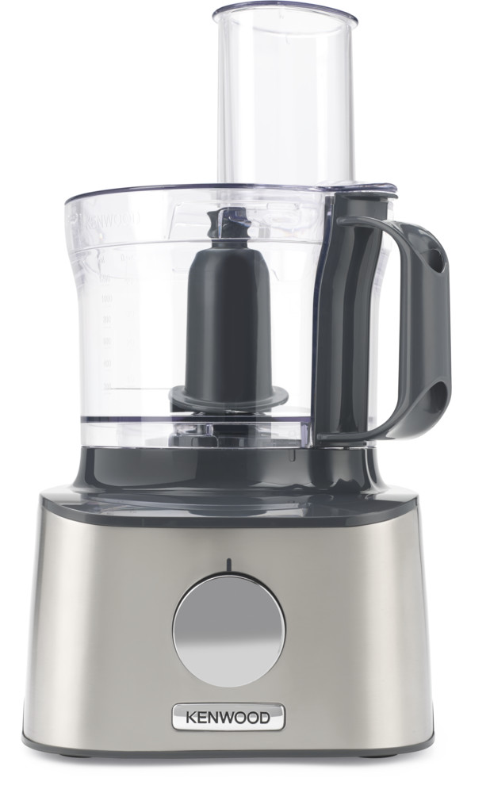
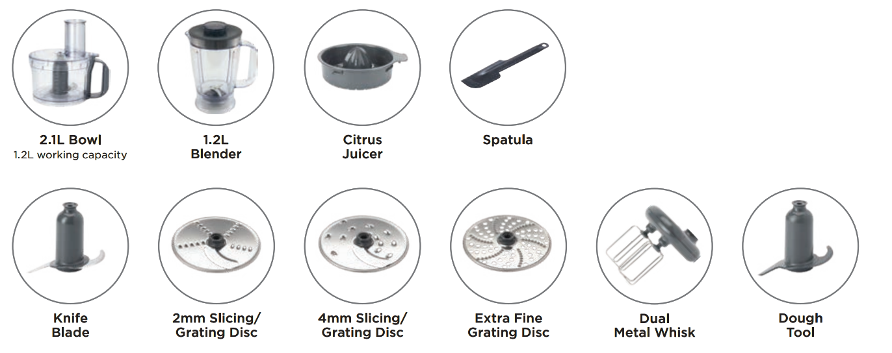
FDM301SS – MultiPro Compact
COMPACT without compromise
Kenwood’s MultiPro Compact offers the widest variety of high-quality accessories and is designed to offer all the support you need in the kitchen whilst only taking up minimal kitchen space. The original all-in-one system from Kenwood also means you can chop, blend, knead and even whisk using the same base!
Key features:
Key Features
Dual Metal Whisk
Perfectly whipped cream and light airy meringue with Kenwood's unique dual metal whisk.
1.2L
working
1.2L
working
2.1L Bowl Capacity
1.2L Blender Capacity
Blender
Lightweight 1.2L blender perfect for smoothies, shakes and soups.
What’s in the box?
Citrus Juicer
The citrus juicer makes fast work of juicing oranges, lemons and limes.
Versatile Discs
3 discs for a choice of coarse and fine slicing and grating.

Slide 2
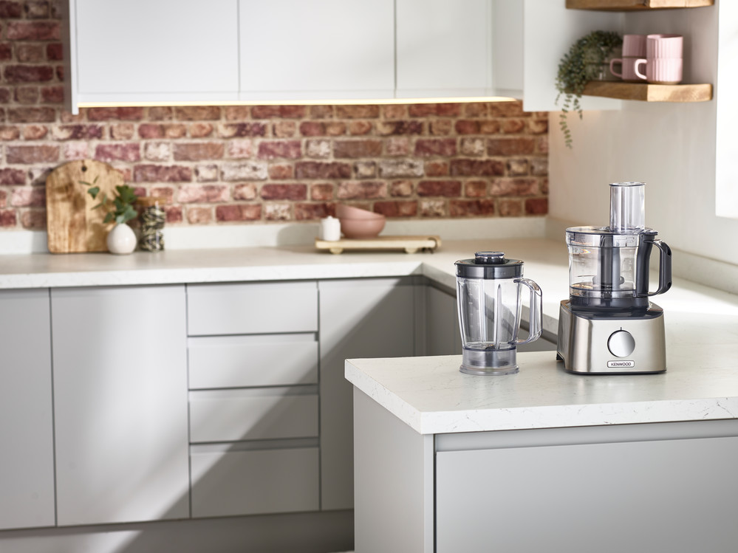
FDM301SS – MultiPro Compact
Product Details
Colour | Brushed stainless steel
Materials | Stainless steel and plastic
Dimensions (unit + bowl; cm) | 36.9H x 21.1W x 25.6D
Weight (unit + bowl; kg) | 2.39
 | Packaging | Single Pack | Multi Pack
FDM301SS | Size (cm) | 45L x 27.7W x 36.4H | N/A
 | Weight (kg) | 5.84 | N/A
Container Qty | 20ft | 40ft | 40ft H | MOQ
FDM301SS | 630 | 1,284 | 1,498 | 630
SKU | Description | Barcode
0W22011035 | FDM301SS FP KW +PBL+SS+3D+DT+DW+CP INT | Single Pack | 5011423195940
 |  | Multi Pack | N/A

