Slide 1
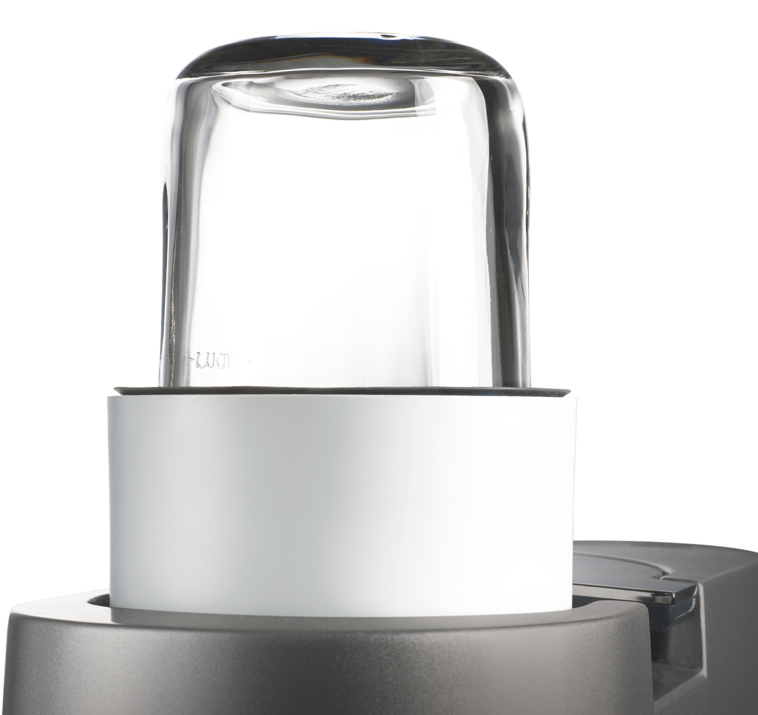
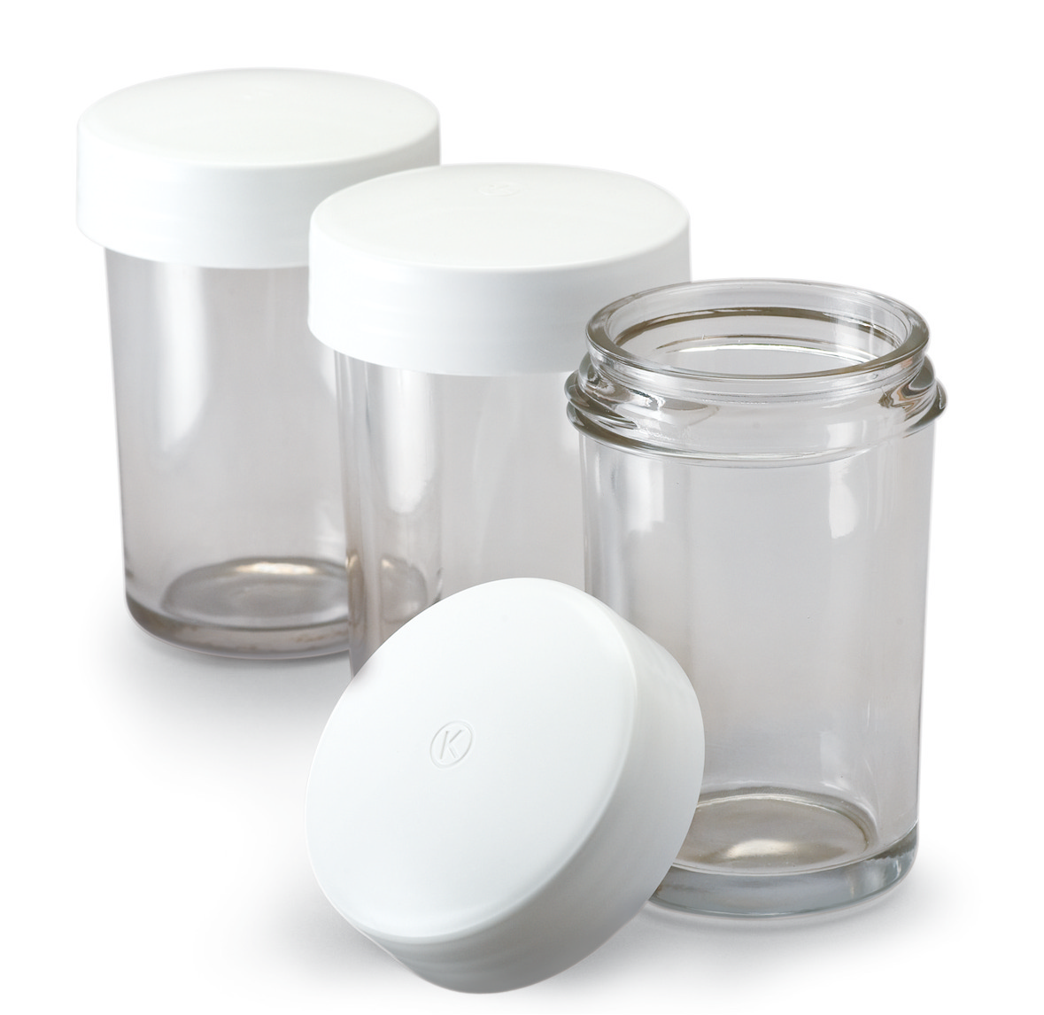
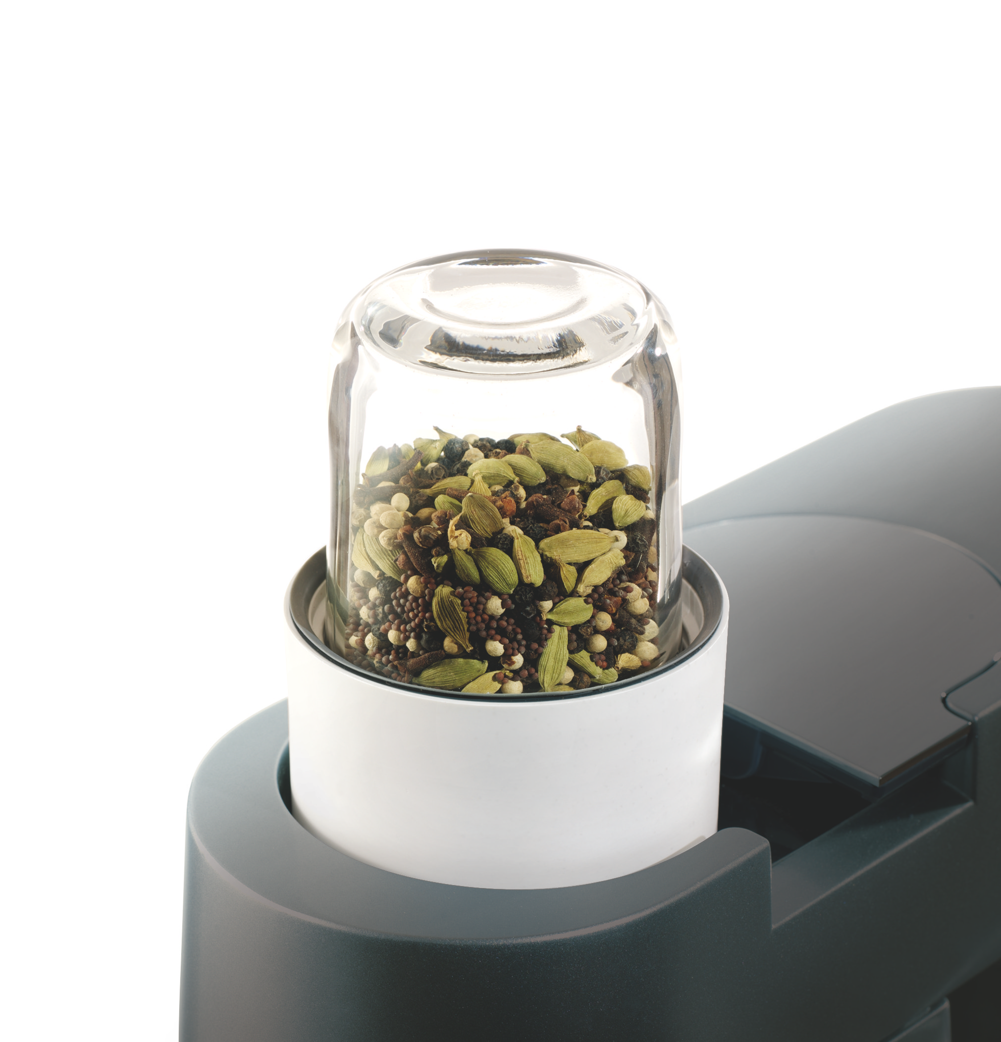
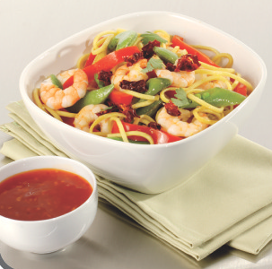
Kitchen Machine
Attachments
AT320A
Mini Chopper / Mill
The KENWOOD CHEF can be customised by adding any of our optional attachments to suit different tastes and skill levels. Our attachments have been developed to deliver good, consistent results time after time.
Product features and benefits
Highly versatile attachment, perfect for many different types of chopping, milling and grinding
Ideal for hard spices used for curries and marinades
Perfect for grinding fresh coffee beans to varying coarseness depending on grinding time
3 additional jars included that can each be used to ‘mill and store’

Slide 2
Product details
Colour: Clear, white
Size (cm): 15.0H x 10.0W x 10.0D
Weight: 1.5kg
Materials: Glass jars, polypropylene base
Packaging
Single pack
Size (cm): 15.7H x 19.2W x 19.2D
Weight: 1.8kg
Multi Pack
Size (cm): 18.2H x 20.4W x 40.2D
Weight: 4.2kg
Container quantities
20ft – 3828
40ft – 7876
40ft HQ – 9048
MOQ – 100

