Slide 1
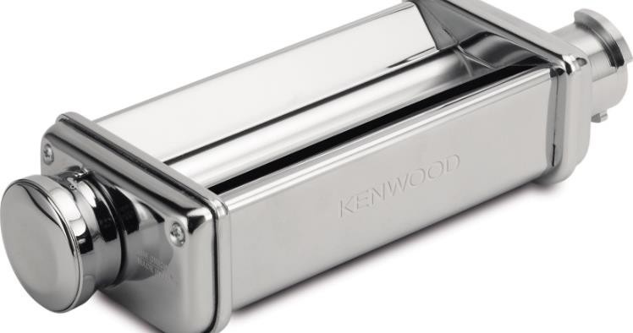
KAX980ME – Lasagne Roller
KM Attachment
The KENWOOD CHEF can be customised by adding a wide range of optional attachments expanding the functionality to perform practically all food preparation tasks. Our high quality attachments have been developed to deliver great, consistent results time after time.
The Kenwood Pasta Cutters have been engineered to effortlessly produce classic Italian pasta dishes using the freshest ingredients.
Heavy duty stainless steel body
Highly durable and excellent for large quantities
Adjustable control dial
10 variable thickness settings
Easy clean
Integral side rings, to eliminate
flour and pasta entrapment for
easy cleanability
Create fresh, authentic pasta sheets for the perfect Lasagne
Compatibility
KAX980ME – Twist Fit attachment
For Chef and kMix ranges

Slide 2
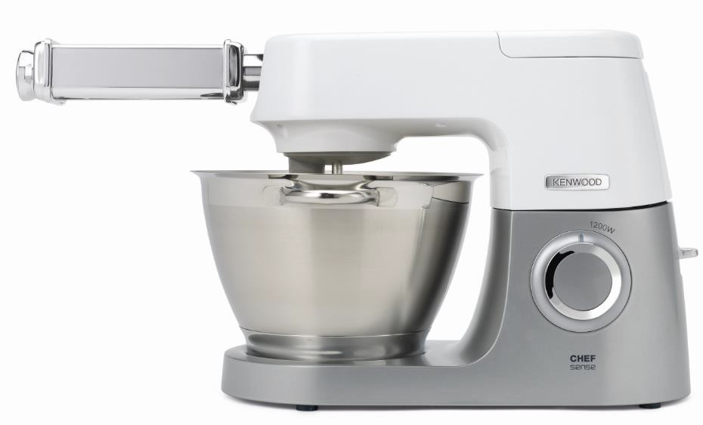
KM Attachment
Product Details
Colour | Silver
Materials | Stainless Steel
KAX980ME – Lasagne Roller
 | Packaging | Single Pack | Multi Pack
KAX980ME | Size (cm) | 25.7L x 16.1W x 7.8H | 34L x 33W x 27.5H
 | Weight (kg) | 1.44 | 11.94
MOQ | PCS
KAX980ME | 3000
SKU | Description | Barcode
AW20011034 | KAX980ME ATT KW LASAGNE ROLLER INT | Single Pack | 5011423197074

