Slide 1
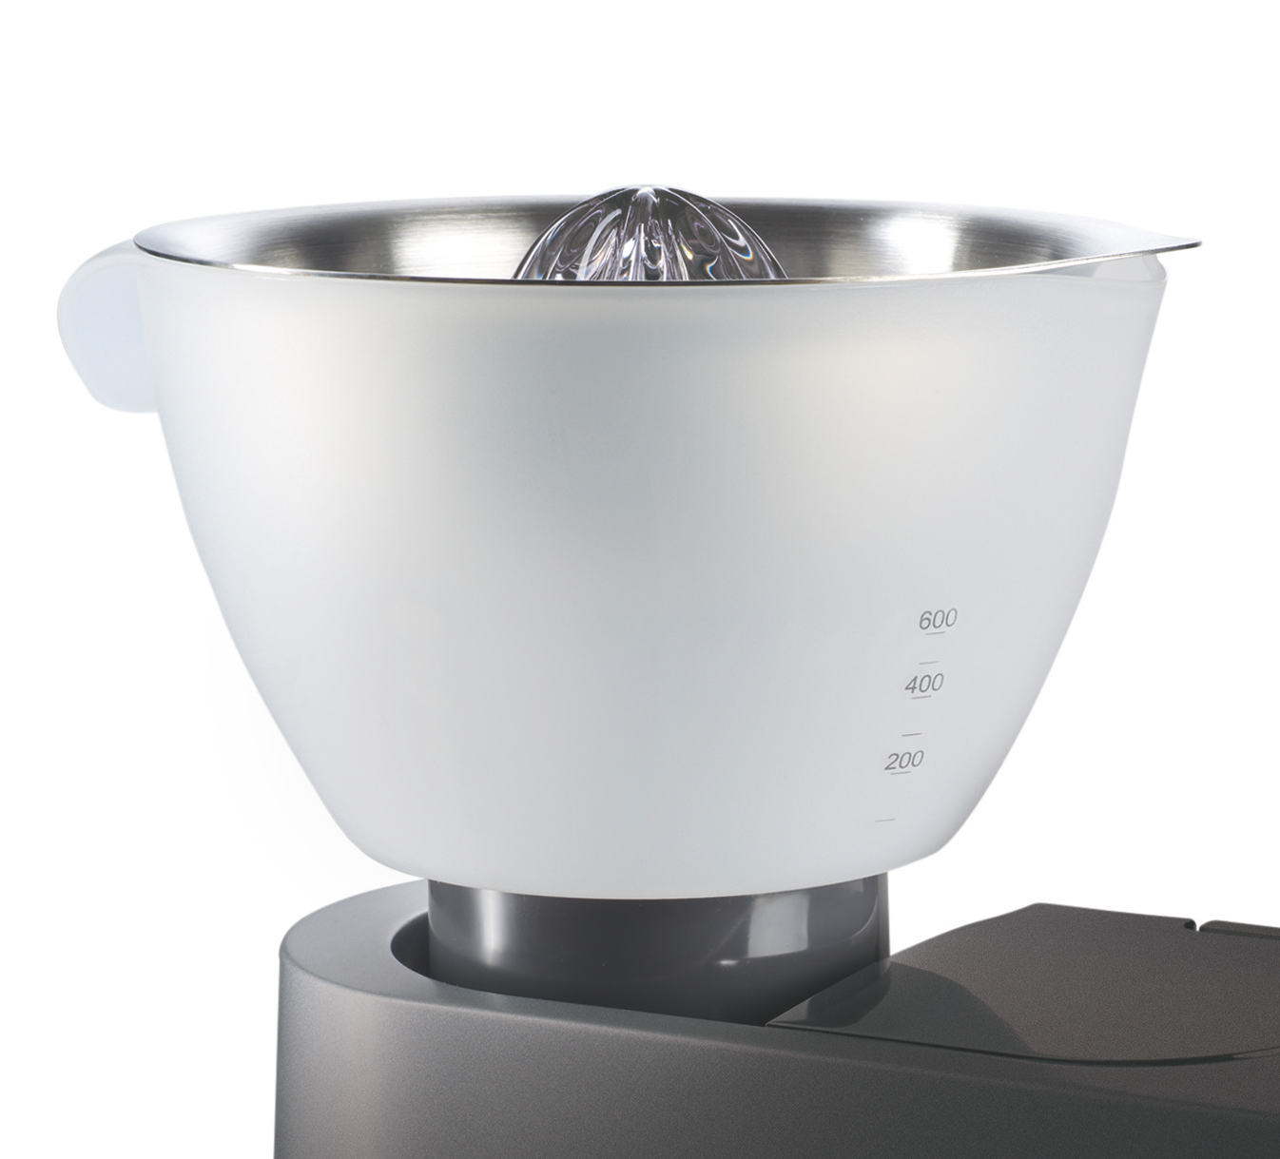

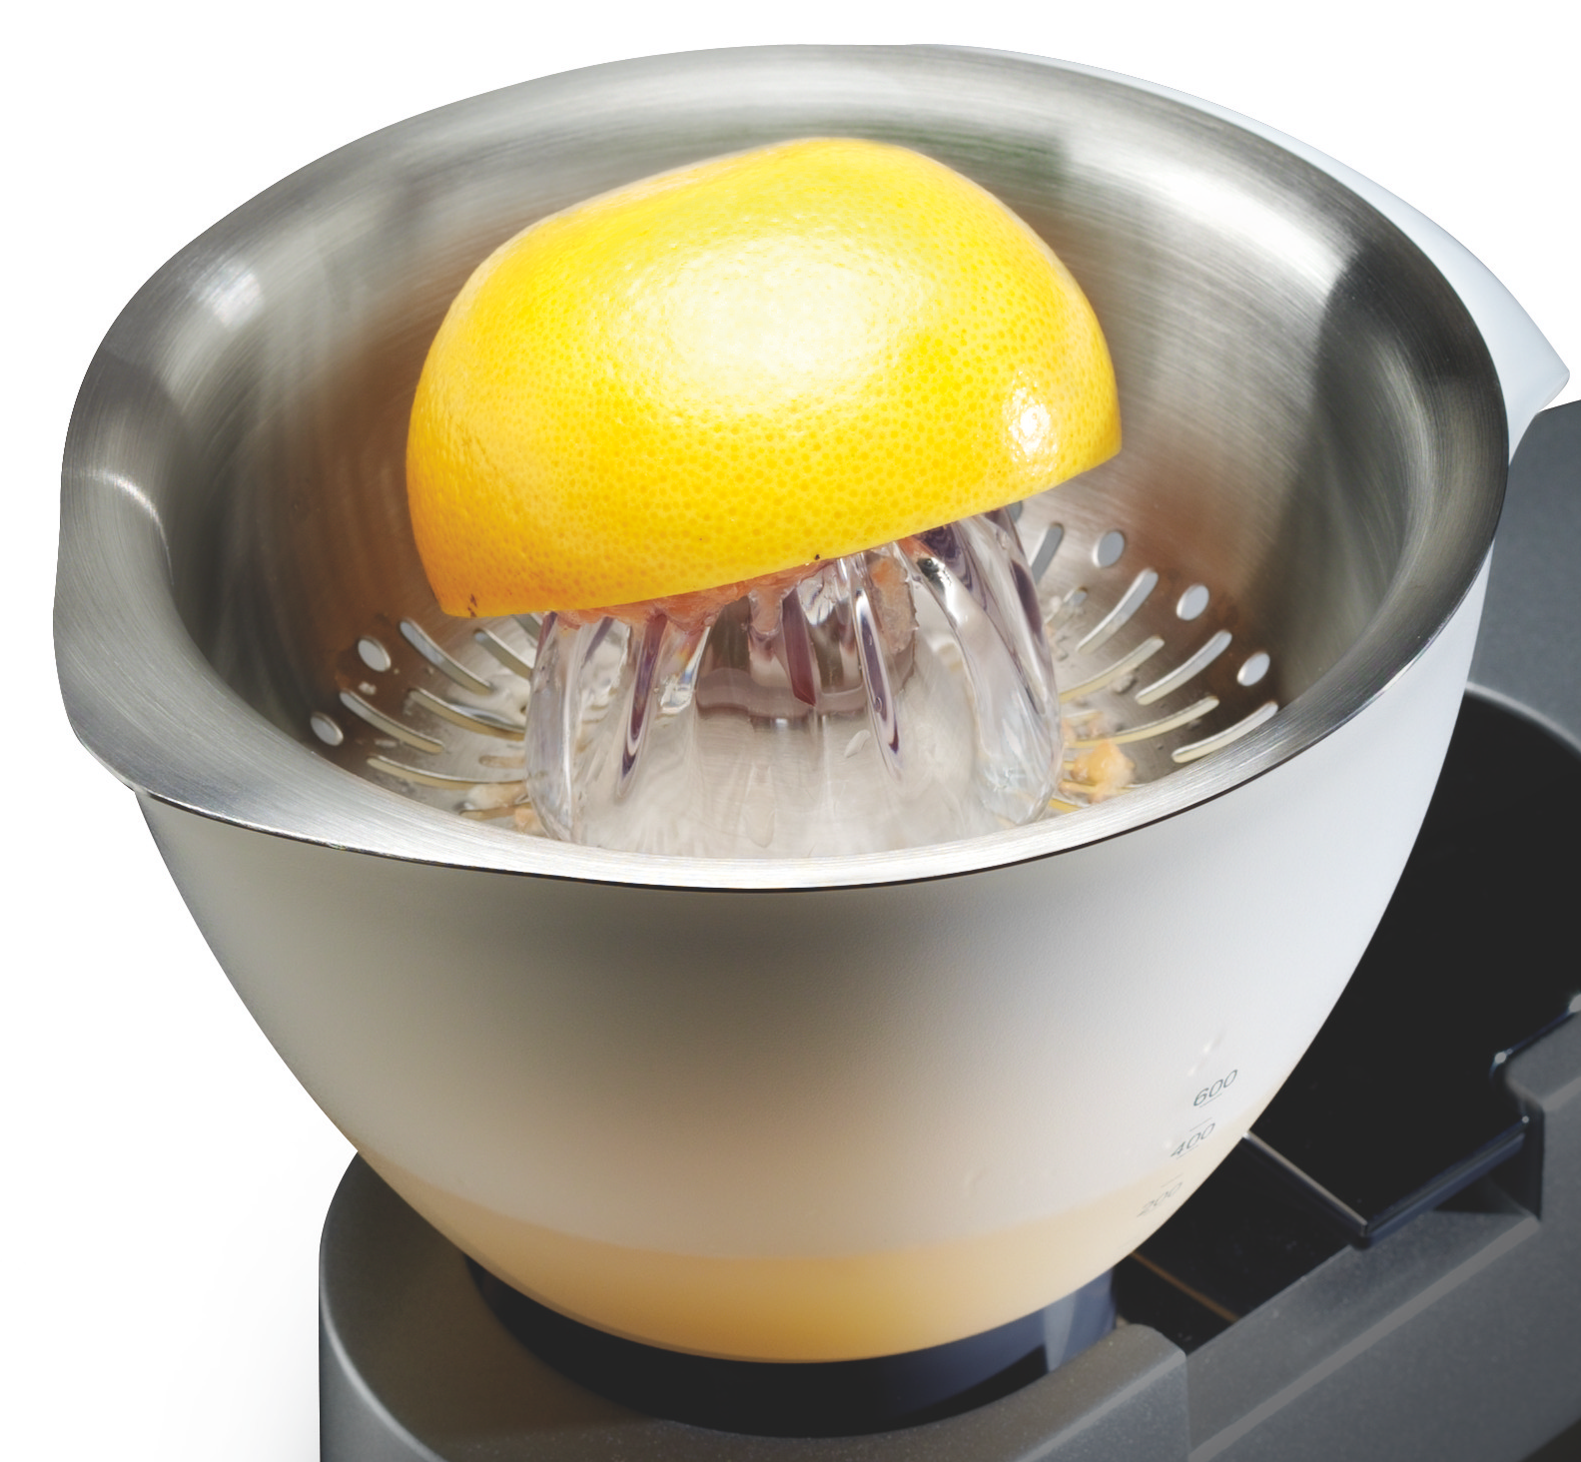

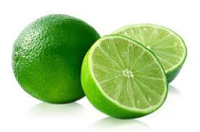
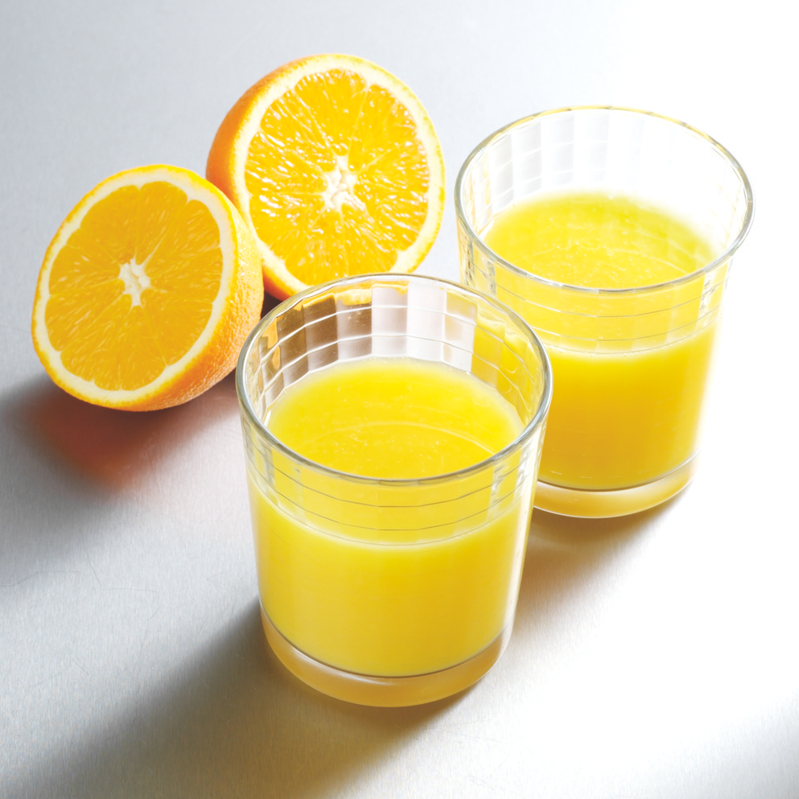
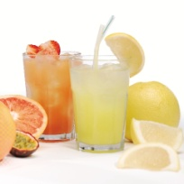
Kitchen Machine Attachment
AT312
Citrus Press
The KENWOOD CHEF can be customised by adding a wide range of optional attachments expanding the functionality to perform practically all food preparation tasks. Our high quality attachments have been developed to deliver, good consistent results time after time.
The Citrus Press combines a household classic with Kenwood’s trademark innovation to squeeze every last drop of juice from all citrus fruits.
Product features and benefits
Capacity
600ml total bowl capacity
Variety
Suitable for all types of citrus fruit from limes to grapefruits
Dishwasher safe
For easy cleaning and assembly
Easy to use
Large juice bowl with handle and spout for easy pouring
Design
Stainless steel sieve for optimum juicing

Slide 2
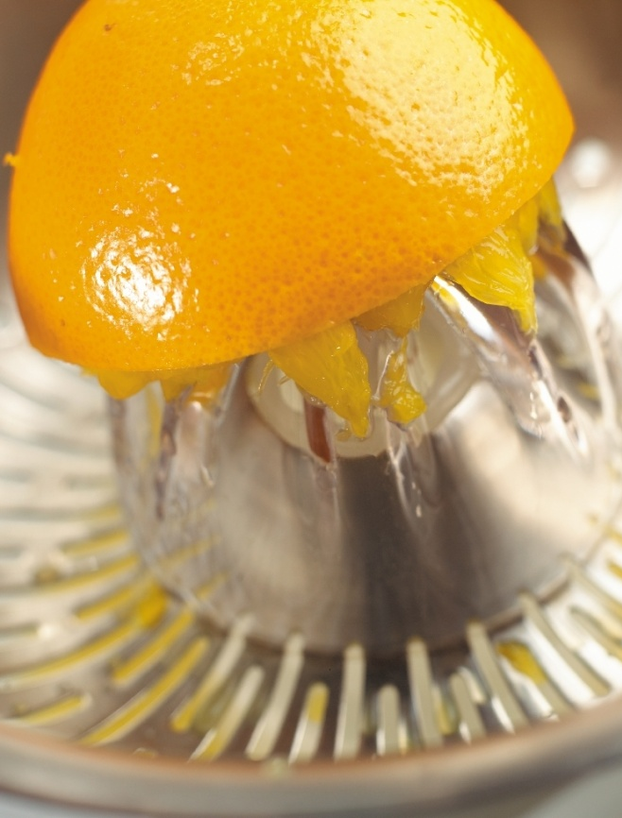
Product details
Colour: Silver and frosted
Size (cm): 16.5H x 21W x 21D
Weight: 0.9kg
Materials: Stainless steel strainer, polypropylene bowl, acrylic reamer
Packaging
Single pack
Size (cm): 18.0H x 21.6W x 21D
Weight: 1.2kg
Barcode: 5011423105888
Multi pack
Size (cm): 20.5H x 43.7W x 22.8D
Weight: 2.6kg
Barcode: 25011423142818
Container quantities
20ft – 2860
40ft – 5940
40ft H – 6732
MOQ – 100

